Slide 1
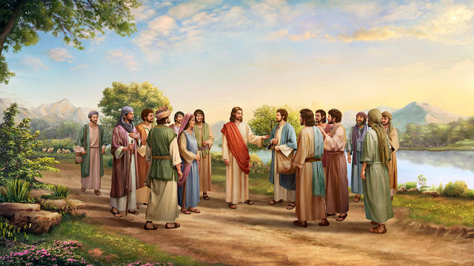
耶稣是基督，永生神的儿子 Jesus is the Christ, the Son of the Living God 可8：27-33

Slide 2
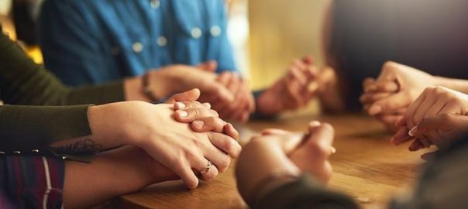
祈祷/Prayer

Slide 3
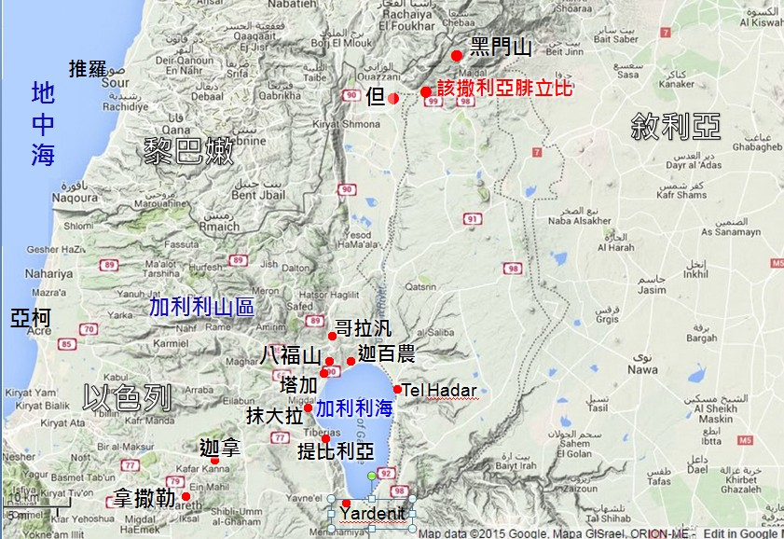
一、人说我人子是谁? I. Who do people say I am?

Slide 4
从耶路撒冷下来的文士说：“他是被别西附着。又说他是靠着鬼王赶鬼” And the teachers of the law who came down from Jerusalem said, ‘He is possessed by Beelzebul! By the prince of demons he is driving out demons.’ 可/Mark 3：22 耶稣的亲属听见，就出来要拉住他，因为他们说他癫狂了 When his family heard about this, they went to take charge of him, for they said, ‘He is out of his mind. 可/Mark 3：21

Slide 5
他们就大大地惧怕，彼此说：“这到底是谁，连风和海也听从他了？” They were terrified and asked each other, ‘Who is this? Even the wind and the waves obey him!’ 可/Mark 4：41

Slide 6
32天晚日落的时候，有人带着一切害病的，和被鬼附的，来到耶稣跟前。33合城的人都聚集在门前。34耶稣治好了许多害各样病的人，又赶出许多鬼，不许鬼说话，因为鬼认识他。 32That evening after sunset the people brought to Jesus all who were ill and demon-possessed. 33The whole town gathered at the door, 34and Jesus healed many who had various diseases. He also drove out many demons, but he would not let the demons speak because they knew who he was. 可/Mark 1:32-34

Slide 7
20那时，西庇太儿子的母亲，同她两个儿子上前来拜耶稣，求他一件事。21耶稣说，你要什么呢？她说，愿你叫我这两个儿子在你国里，一个坐在你右边，一个坐在你左边。 20Then the mother of Zebedee’s sons came to Jesus with her sons and, kneeling down, asked a favour of him.21‘What is it you want?’ he asked.She said, ‘Grant that one of these two sons of mine may sit at your right and the other at your left in your kingdom.’ 太/Matt. 20:20-21

Slide 8
25既在海那边找着了，就对他说，拉比，是几时到这里来的。 26耶稣回答说，我实实在在地告诉你们，你们找我，并不是因见了神迹，乃是因吃饼得饱。 25When they found him on the other side of the lake, they asked him, ‘Rabbi, when did you get here?’26Jesus answered , ‘Very truly I tell you, you are looking for me, not because you saw the signs I performed but because you ate the loaves and had your fill. 约/John 6:25-26

Slide 9
二、你们说我是谁? II. Who do you say I am? 15耶稣说，你们说我是谁。16西门彼得回答说，你是基督，是永生神的儿子。 ‘But what about you?’ he asked. ‘Who do you say I am?’ Simon Peter answered, ‘You are the Messiah, the Son of the living God.’ 太/Matt. 16:15-16

Slide 10
从来没有人看见过神，只有在父怀里的独生子将他表明出来。 No one has ever seen God, but the one and only Son, who is himself God and is in the closest relationship with the Father, has made him known. 人看见了我，就是看见了父。 Anyone who has seen me has seen the Father. 我与父原为一。 I and the Father are one.’ 约/John 1：18; 14：9; 10：30

Slide 11
三、主啊，万不可如此！这事必不临到你身上 III. Never, Lord! This shall never happen to you 17耶稣对他说，西门巴约拿，你是有福的。因为这不是属血肉的指示你的，乃是我在天上的父指示的。 Jesus replied, ‘Blessed are you, Simon son of Jonah, for this was not revealed to you by flesh and blood, but by my Father in heaven. 太/Matt. 16：17

Slide 12
33耶稣转过来，看着门徒，就责备彼得说，撒但，退我后边去吧。因为你不体贴神的意思，只体贴人的意思。 33But when Jesus turned and looked at his disciples, he rebuked Peter. ‘Get behind me, Satan!’ he said. ‘You do not have in mind the concerns of God, but merely human concerns.’ 可/Mark 8:33

Slide 13
31从此他教训他们说，人子必须受许多的苦，被长老祭司长和文士弃绝，并且被杀，过三天复活。 31He then began to teach them that the Son of Man must suffer many things and be rejected by the elders, the chief priests and the teachers of the law, and that he must be killed and after three days rise again. 可/Mark 8：31

Slide 14
22彼得就拉着他，劝他说，主阿，万不可如此，这事必不临到你身上。 22Peter took him aside and began to rebuke him. ‘Never, Lord!’ he said. ‘This shall never happen to you!’ 太/Matt. 16:22

Slide 15
祈祷/Prayer

