Slide 1
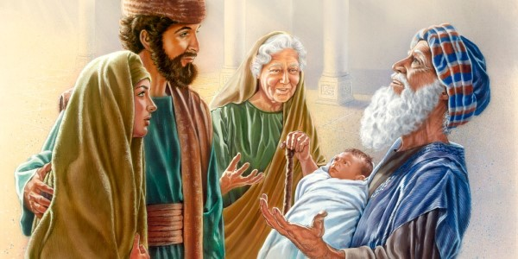
心存盼望、等候救主 With a hopeful heart, waiting for the Savior 路/Luke2：36-38

Slide 2
祈祷/Prayer

Slide 3
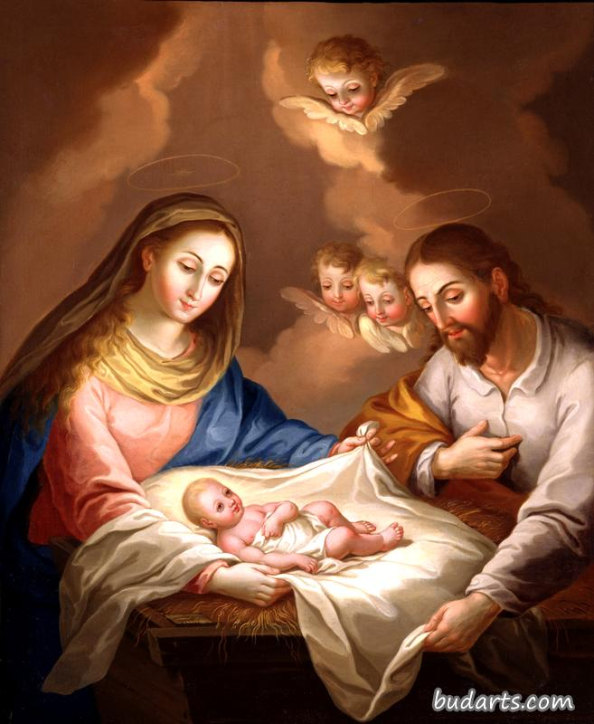
一、经文内容 I. The context of Scripture

Slide 4
29主阿，如今可以照你的话，释放仆人安然去世。30因为我的眼睛已经看见你的救恩。31就是你在万民面前所预备的。32是照亮外邦人的光，又是你民以色列的荣耀。 29‘Sovereign Lord, as you have promised,you may now dismiss your servant in peace. 30For my eyes have seen your salvation, 31which you have prepared in the sight of all nations:32a light for revelation to the Gentiles,and the glory of your people Israel.’

Slide 5
二、一生充满忧患的亚拿 II. Ana, Whose life was filled adversity 36又有女先知名叫亚拿，是亚设支派法内力的女儿，年纪已经老迈，从作童女出嫁的时候，同丈夫住了七年，就寡居了。 36There was also a prophet, Anna, the daughter of Penuel, of the tribe of Asher. She was very old; she had lived with her husband seven years after her marriage.

Slide 6
 | 压力事件 | 压力分值
1 | 配偶死亡 | 100分
2 | 离婚 | 73分
3 | 分居 | 65分
4 | 判刑 | 63分
5 | 亲密家庭成员死亡 | 53分
6 | 受伤或者生病 | 53分
7 | 结婚 | 50分
8 | 失业 | 47分
9 | 退休 | 45分
10 | 换工作 | 37分
11 | 与配偶的争吵越来越多 | 36分
12 | 儿子或者女儿离开家 | 29分
13 | 配偶停止工作 | 28分
14 | 开始上学或者结束学业 | 26分
15 | 与老板发生矛盾 | 24分
16 | 假期 | 13分
17 | 春节/感恩节/圣诞节 | 12分

Slide 7
22坚固门徒的心，劝他们恒守所信的道。又说，我们进入神的国，必须经历许多艰难。 22strengthening the disciples and encouraging them to remain true to the faith. ‘We must go through many hardships to enter the kingdom of God,’ they said. 徒/Acts 14:22

Slide 8
三、孤单却不孤独的亚拿 II. Ana, who was alone but not loneliness 37 现在已经八十四岁，（或作就寡居了八十四年）并不离开圣殿，禁食祈求，昼夜事奉神。 37and then was a widow until she was eighty-four. She never left the temple but worshipped night and day, fasting and praying.

Slide 9
路/luke 2:36又有女先知名叫亚拿，是亚设支派法内力的女儿。36There was also a prophet, Anna, the daughter of Penuel, of the tribe of Asher. 24论亚设说，愿亚设享受多子的福乐，得他弟兄的喜悦，可以把脚蘸在油中。25你的门闩是铜的，铁的。你的日子如何，你的力量也必如何。25The bolts of your gates will be iron and bronze,and your strength will equal your days. 申/Deu. 33：24-25

Slide 10
四、得着福音、见证福音的亚拿 IV. Ana, who received the gospel and bore witness to the gospel 38 正当那时，她进前来称谢神，将孩子的事，对一切盼望耶路撒冷得救赎的人讲说。 38 Coming up to them at that very moment, she gave thanks to God and spoke about the child to all who were looking forward to the redemption of Jerusalem.

Slide 11
“请停下恭喜我吧！从7/3 OPT结束到今天H1b 工签通过，将近5个月的时间，一周一周盼下周、每日每日望明日的煎熬终于结束了……”。

Slide 12
总结 Summary
3若有人爱神，这人乃是神所知道的。
3 Whoever loves God is known by God.
林前/1Cor.8:3

