Slide 1
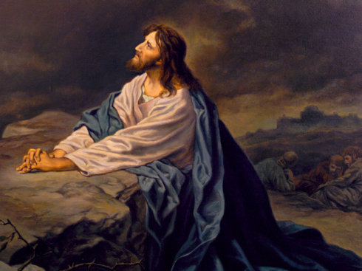
客西马尼园中的祷告 Jesus Prays in the Garden of Gethsemane 可/Mark 14：32-42

Slide 2
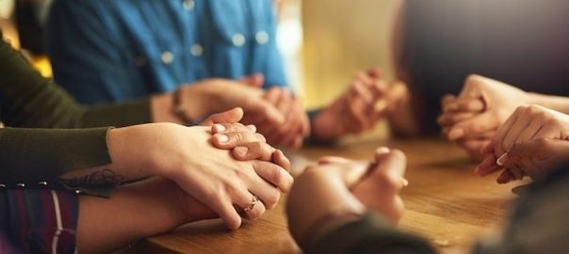
祈祷/Prayer

Slide 3
一、主耶稣的痛苦 I.The Suffering of Juses 32他们来到一个地方，名叫客西马尼。耶稣对门徒说，你们坐在这里，等我祷告。33于是带着彼得，雅各，约翰同去，就惊恐起来，极其难过。34对他们说，我心里甚是忧伤，几乎要死。你们在这里，等候儆醒。 32They went to a place called Gethsemane, and Jesus said to his disciples, ‘Sit here while I pray.’ 33He took Peter, James and John along with him, and he began to be deeply distressed and troubled. 34‘My soul is overwhelmed with sorrow to the point of death, he said to them.‘Stay here and keep watch. 可/Mark 14:32-34

Slide 4
二、耶稣处理痛苦的方式 II、The way that Jesus dealt with his suffering 35他就稍往前走，俯伏在地祷告说，倘若可行，便叫那时候过去。36他说，阿爸，父阿，在你凡事都能。求你将这杯撤去。 35Going a little farther, he fell to the ground and prayed that if possible the hour might pass from him. 36‘Abba, Father,’ he said, ‘everything is possible for you. Take this cup from me. Yet not what I will, but what you will.’ 可/Mark14：35-36

Slide 5
32 ……等我祷告/Sit here while I pray 35 ……俯伏在地祷告/he fell to the ground and prayed 38 ……总要警醒祷告/Watch and pray 39 ……又去祷告/Once more he went away and prayed

Slide 6
三、耶稣祷告的内容 III. The content of Jesus’ prayer 36他说，阿爸，父阿，在你凡事都能。求你将这杯撤去。然而不要从我的意思，只要从你的意思。 36‘Abba, Father,’ he said, ‘everything is possible for you. Take this cup from me. Yet not what I will, but what you will.’ 可 14：36

Slide 7
39我父阿，倘若可行，求你叫这杯离开我。然而不要照我的意思，只要照你的意思……42第二次又去祷告说……44耶稣又离开他们去了。第三次祷告，说的话还是与先前一样。 39‘My Father, if it is possible, may this cup be taken from me. Yet not as I will, but as you will.’42He went away a second time and prayed…44So he left them and went away once more and prayed the third time, saying the same thing. 太/Mat.26:39-44

Slide 8
44 耶稣极其伤痛，祷告更加恳切，汗珠如大血点，滴在地上。 44And being in anguish, he prayed more earnestly, and his sweat was like drops of blood falling to the ground. 路/Luke 22:44

Slide 9
23我实在告诉你们，无论何人对这座山说，你挪开此地投在海里。他若心里不疑惑，只信他所说的必成，就必给他成了。24所以我告诉你们，凡你们祷告祈求的，无论是什么，只要信是得着的，就必得着。 23‘Truly I tell you, if anyone says to this mountain, “Go, throw yourself into the sea,” and does not doubt in their heart but believes that what they say will happen, it will be done for them. 24Therefore I tell you, whatever you ask for in prayer, believe that you have received it, and it will be yours. 可/Mark 11:23-24

Slide 10
42起来，我们走吧。看哪，那卖我的人近了。 42 Rise! Let us go! Here comes my betrayer!’ 可/Mark 14:42

Slide 11
7有一根刺加在我肉体上……为这事，我三次求过主，叫这刺离开我。9他对我说，我的恩典够你用的。因为我的能力，是在人的软弱上显得完全。 7I was given a thorn in my flesh…Three times I pleaded with the Lord to take it away from me. 9But he said to me, ‘My grace is sufficient for you, for my power is made perfect in weakness.’ 林后/2 Cor.12:7-9

Slide 12
总结 Summary

