Slide 1

在圣灵里的生活/Life in the Holy Spirit
罗/Rom. 8:1–17

Slide 2

祈祷/Prayer

Slide 3
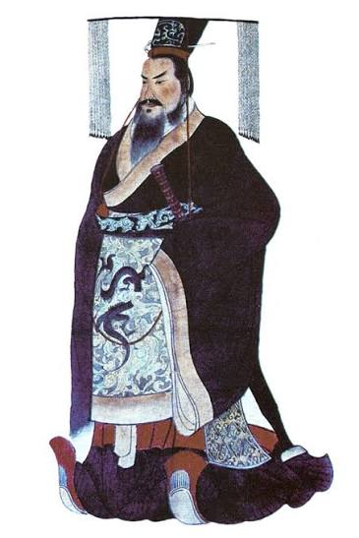

一

Slide 4
一、圣灵的释放——从定罪到自由8:1–4
I. The Spirit’s Deliverance — From Condemnation to Freedom (vv. 1–4)

Slide 5
8:1如今，那些在基督耶稣里的就不定罪了……3律法既因肉体软弱，有所不能行的，神就差遣自己的儿子成为罪身的形状，作了赎罪祭，在肉体中定了罪案。
1Therefore, there is now no condemnation for those who are in Christ Jesus…3For what the law was powerless to do because it was weakened by the flesh, God did by sending his own Son in the likeness of sinful flesh to be a sin offering. And so he condemned sin in the flesh.

Slide 6
8:1如今，那些在基督耶稣里的就不定罪了。2因为赐生命圣灵的律在基督耶稣里释放了我，使我脱离罪和死的律了。
1Therefore, there is now no condemnation for those who are in Christ Jesus, 2because through Christ Jesus the law of the Spirit who gives life has set you free from the law of sin and death.

Slide 7
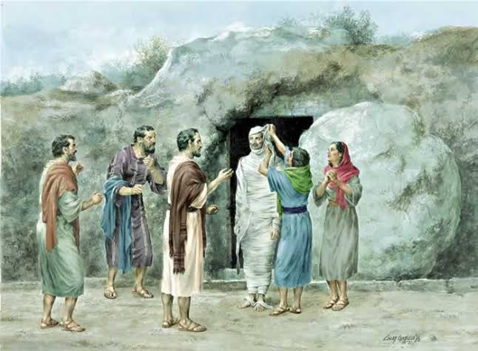

Slide 8
二、圣灵的更新——从体贴肉体到体贴圣灵8:5–8
II. The Spirit’s Renewal — From Setting Our Minds on the Flesh to Setting Our Minds on the Spirit (vv. 5–8)

Slide 9
5 因为随从肉体的人，体贴肉体的事；随从圣灵的人，体贴圣灵的事。
5Those who live according to the flesh have their minds set on what the flesh desires; but those who live in accordance with the Spirit have their minds set on what the Spirit desires.

Slide 10
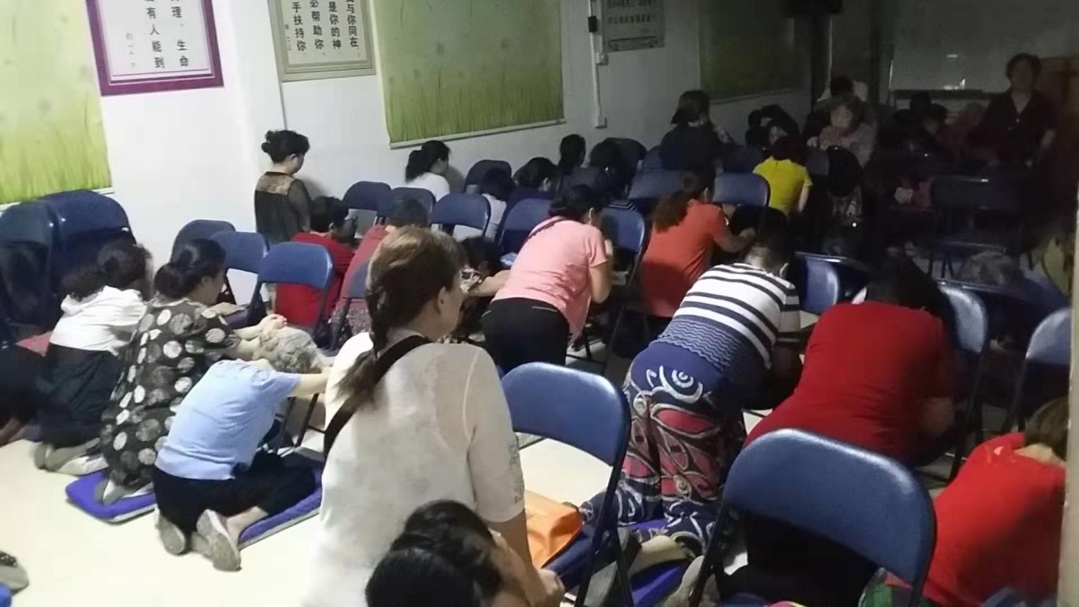
《中国的早晨五点钟》
中国的早晨五点钟，传来祈祷声。祈祷带来复兴和平，带来合一得胜。中国的早晨五点钟……。

Slide 11
三、圣灵的内住——从靠自已到靠圣灵8:9–13
III. The Spirit’s Indwelling — From Relying on Ourselves to Relying on the Spirit (vv. 9–13)

Slide 12
9 如果神的灵住在你们心里，你们就不属肉体，乃属圣灵了。
9You, however, are not in the realm of the flesh but are in the realm of the Spirit, if indeed the Spirit of God lives in you. And if anyone does not have the Spirit of Christ, they do not belong to Christ.

Slide 13
四、圣灵的见证——从奴仆的心到儿女的心8:14–17
IV. The Spirit’s Witness — From Slaves to Children of God (vv. 14–17)

Slide 14
14 因为凡被神的灵引导的，都是神的儿子\For those who are led by the Spirit of God are the children of God.
16 圣灵与我们的心同证我们是神的儿女\The Spirit himself testifies with our spirit that we are God’s children.

Slide 15
15 你们所受的不是奴仆的心，仍旧害怕；所受的乃是儿子的心，因此我们呼叫：‘阿爸！父！’”
15The Spirit you received does not make you slaves, so that you live in fear again; rather, the Spirit you received brought about your adoption to sonship. And by him we cry, “Abba, Father.”

Slide 16
总结
Summary

