Slide 1
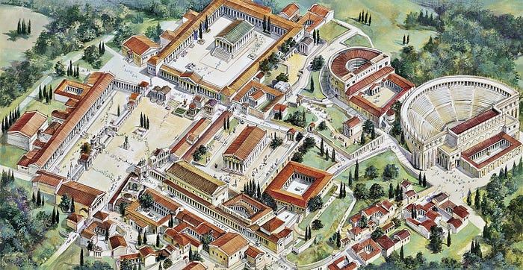
保罗在哥林多城的宣教 Paul’s Mission Trip in the City of Corinth 徒/Acts 18:1-11

Slide 2
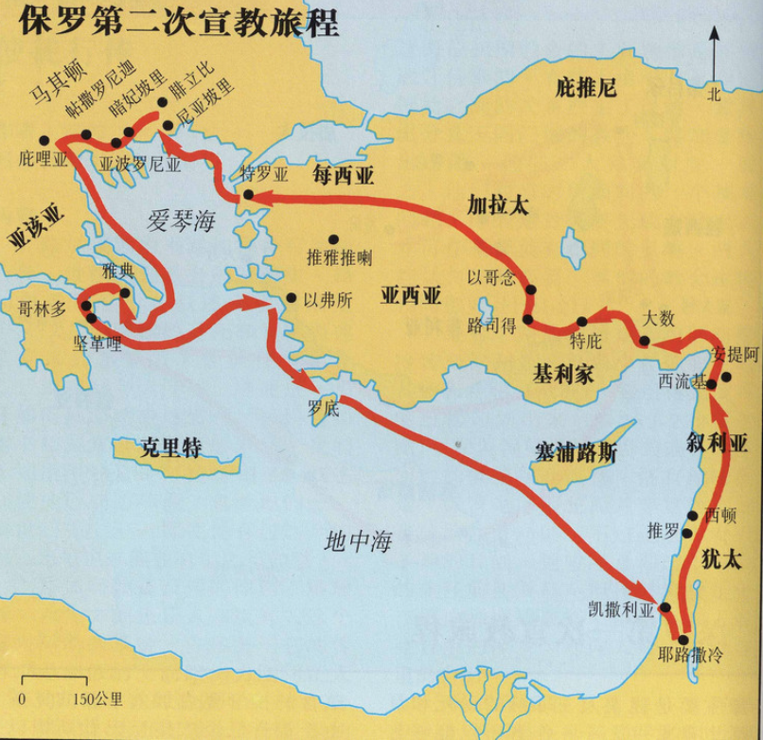

Slide 3
祈祷/Prayer

Slide 4
一、哥林多城 I. The City of Crointh

Slide 5
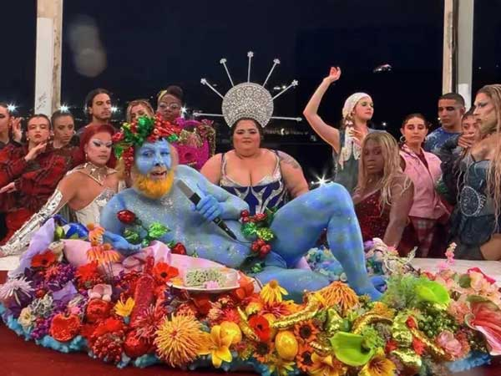
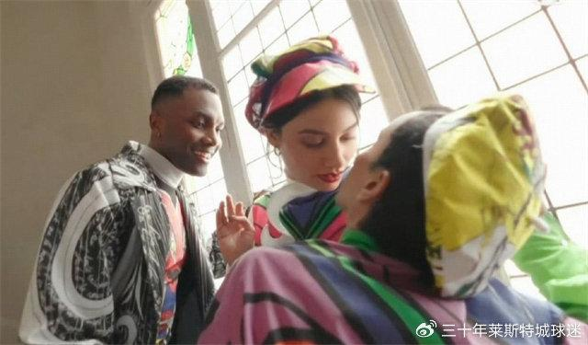

Slide 7
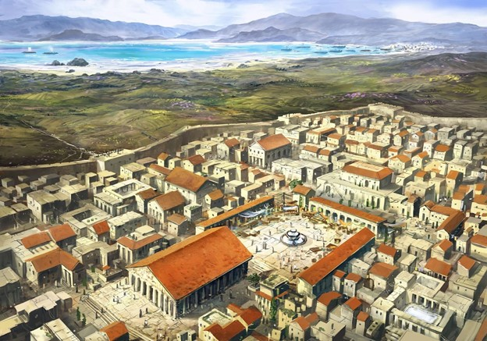
Κορινθιάζομαι (Corinthiazomai): 1、To act like a person from the city-state of Corinth；
2、To consort with prostitutes, since Corinth was famous in antiquity for its prostitutes

Slide 8
二、保罗的同工：亚居拉和百基拉 II. Paul’s Co-workers: Aquila and Priscilla 1弟兄们，从前我到你们那里去，并没有用高言大智对你们宣传神的奥秘。而是只传耶稣基督并他钉十字架” 。 1And so it was with me, brothers and sisters. When I came to you, I did not come with eloquence or human wisdom as I proclaimed to you the testimony about God. 2For I resolved to know nothing while I was with you except Jesus Christ and him crucified. 林前/1Cor. 2:1-2

Slide 9
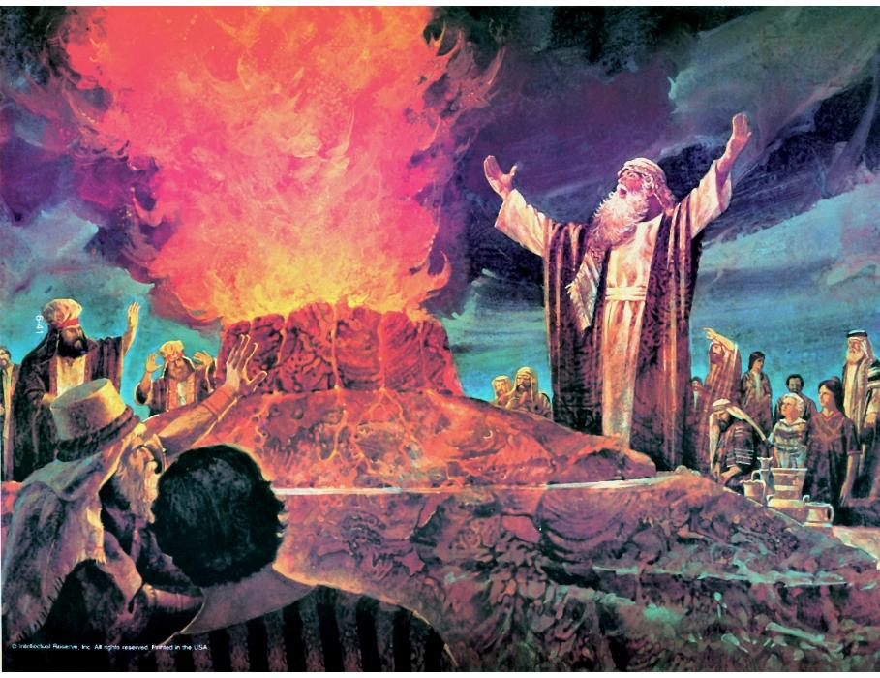
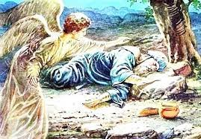
王上18:38耶和华降下火来烧尽燔祭，木柴，石头，尘土，又烧干沟里的水。39众民看见了，就俯伏在地，说，耶和华是神。耶和华是神
王上19：4自己在旷野走了一日的路程，来到一棵罗腾树下就坐在那里求死，说，耶和华阿，罢了。求你取我的性命，因为我不胜于我的列祖。

Slide 10
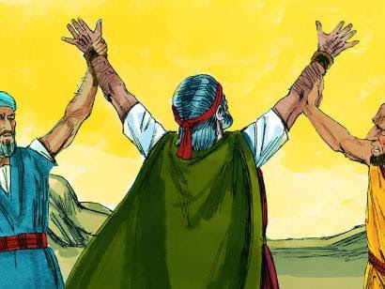

Slide 11
1这事以后，保罗离了雅典，来到哥林多。2遇见一个犹太人，名叫亚居拉，他生在本都。因为革老丢命犹太人都离开罗马，新近带着妻百基拉，从义大利来。保罗就投奔了他们。 1After this, Paul left Athens and went to Corinth. 2There he met a Jew named Aquila, a native of Pontus, who had recently come from Italy with his wife Priscilla, because Claudius had ordered all Jews to leave Rome. Paul went to see them. 徒/Acts 18:1-2

Slide 12
3问百基拉和亚居拉安。他们在基督耶稣里与我同工，4也为我的命，将自己的颈项，置之度外。不但我感谢他们，就是外邦的众教会，也感谢他们。 3Greet Priscilla and Aquila, my fellow workers in Christ Jesus. 4They risked their lives for me. Not only I but all the churches of the Gentiles are grateful to them. 罗/Rom. 16:3-4

Slide 13
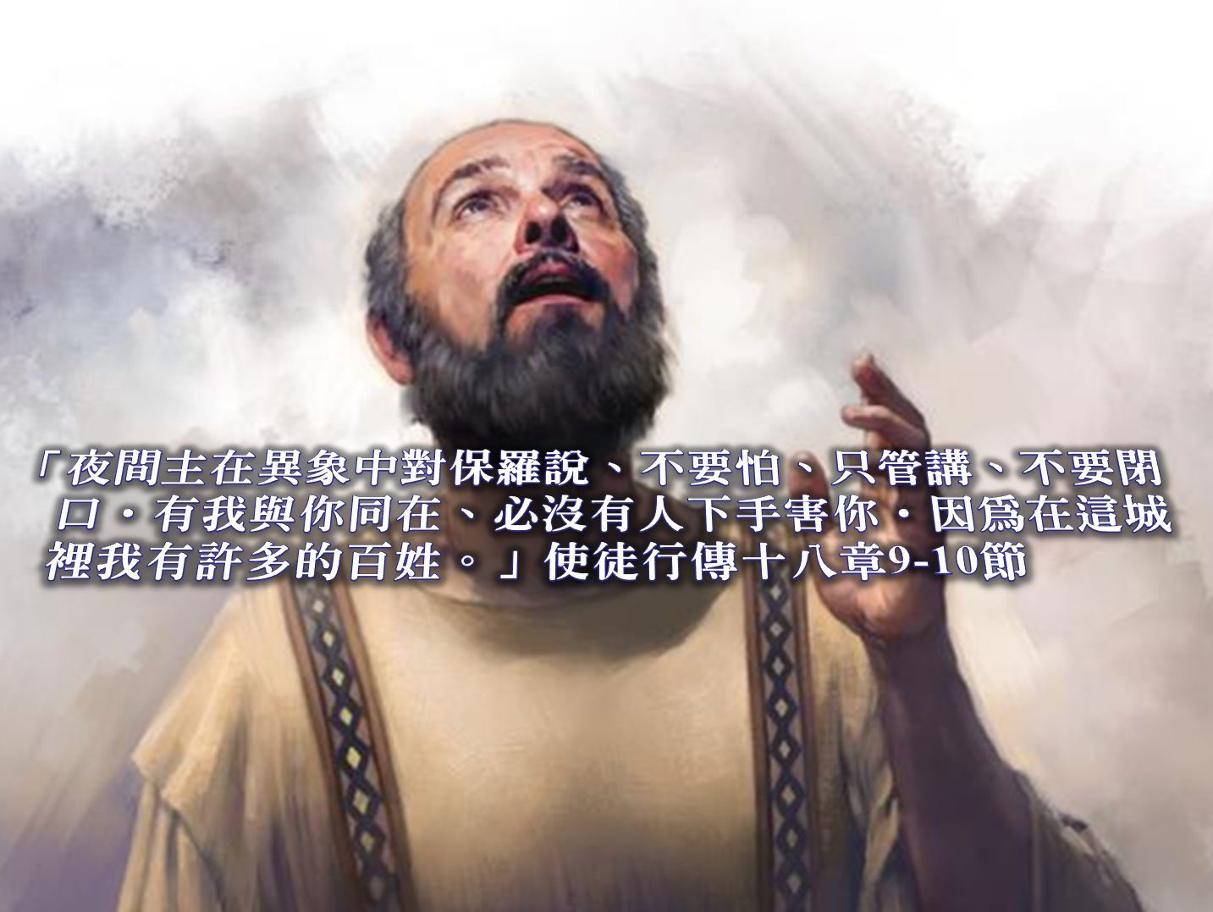
三、不要怕，只管讲，不要闭口 III. Do not be afraid; Keep on speaking, do not be silent.

Slide 14
5保罗为道迫切，向犹太人证明耶稣是基督。 6他们既抗拒，毁谤，保罗就抖着衣裳说，你们的罪归到你们自己头上，与我无干，从今以后，我要往外邦人那里去. 5When Silas and Timothy came from Macedonia, Paul devoted himself exclusively to preaching, testifying to the Jews that Jesus was the Messiah. 6But when they opposed Paul and became abusive, he shook out his clothes in protest and said to them, ‘Your blood be on your own heads! I am innocent of it. From now on I will go to the Gentiles.’ 徒/Acts 18:5-6

Slide 15
9夜间主在异象中对保罗说，不要怕，只管讲，不要闭口。10有我与你同在，必没有人下手害你。因为在这城里我有许多的百姓。 9One night the Lord spoke to Paul in a vision: ‘Do not be afraid; keep on speaking, do not be silent. 10For I am with you, and no one is going to attack and harm you, because I have many people in this city.’ 徒/Acts 18:9-10

Slide 16
总结 Summary

