Slide 1
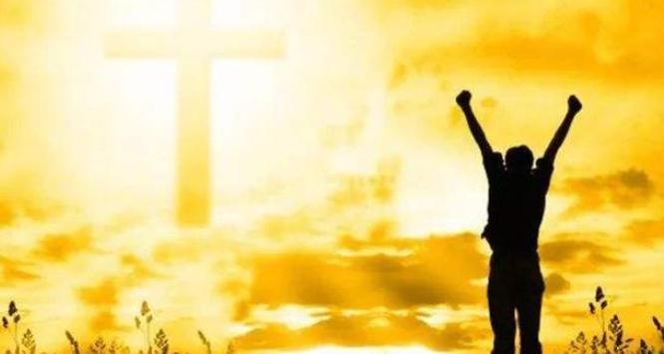
你的目光要转向神
Turn your eyes upon the God
书 1：1-9

Slide 2
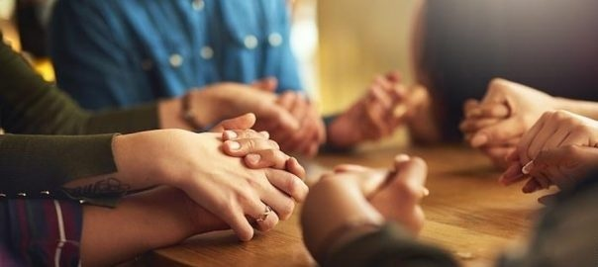
祈祷/Prayer

Slide 3
一、摩西的助手：约书亚
I. Moses’ assistant: Joshua
1：1耶和华的仆人摩西死了以后，耶和华晓谕摩西的帮手，嫩的儿子约书亚，
1After the death of Moses the servant of the Lord, the Lord said to Joshua son of Nun, Moses’ assistant:

Slide 4
摩西对约书亚说，你为我们选出人来，出去和亚玛力人争战。明天我手里要拿着神的杖，站在山顶上。
9Moses said to Joshua, ‘Choose some of our men and go out to fight the Amalekites. Tomorrow I will stand on top of the hill with the staff of God in my hands.’
摩西和他的帮手约书亚起来，上了神的山……在山上四十昼夜。
Then Moses set out with Joshua his assistant, and Moses went up on the mountain of God… he stayed on the mountain forty days and forty nights. 出/Exod. 17：9；24：13-18

Slide 5
14耶和华对摩西说，你的死期临近了。要召约书亚来，你们二人站在会幕里，我好嘱咐他。于是摩西和约书亚去站在会幕里。
14The Lord said to Moses, ‘Now the day of your death is near. Call Joshua and present yourselves at the tent of meeting, where I will commission him.’ So Moses and Joshua came and presented themselves at the tent of meeting.
申/Deu. 31:14

Slide 6
11他们对摩西说，难道在埃及没有坟地，你把我们带来死在旷野吗？你为什么这样待我们，将我们从埃及领出来呢？
12我们在埃及岂没有对你说过，不要搅扰我们，容我们服事埃及人吗？因为服事埃及人比死在旷野还好。
11They said to Moses, ‘Was it because there were no graves in Egypt that you brought us to the desert to die … Didn’t we say to you in Egypt, “Leave us alone; let us serve the Egyptians….
出/Exod. 14:11-12

Slide 7
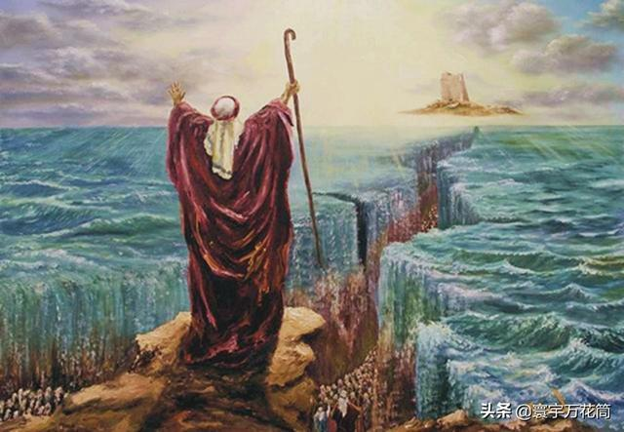
不要惧怕，只管站住，看耶和华今天向你们的要施行的救恩！
‘Do not be afraid. Stand firm and you will see the deliverance the Lord will bring you today.
出/Exod.14：13

Slide 8
又有许多闲杂人，并有羊群牛群，和他们一同上去。
38Many other people went up with them, and also large droves of livestock, both flocks and herds. 出/Exod. 12:38
他们中间的闲杂人大起贪欲的心。以色列人又哭号说，谁给我们肉吃呢？
4The rabble with them began to crave other food, and again the Israelites started wailing and said, ‘If only we had meat to eat!
民/Num.11:4

Slide 9
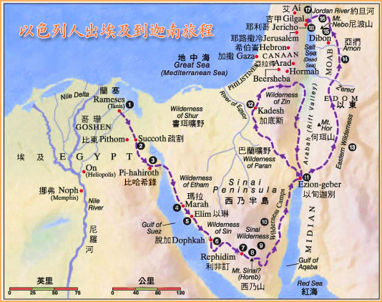
二

Slide 10
二、蒙神呼召的约书亚
II、Joshua: called by God
1、约书亚看自己所带领的以色列人
1.Joshua looks at the Israelites that he was leading

Slide 11
23过了多年，埃及王死了。以色列人因作苦工，就叹息哀求，他们的哀声达于神。24神听见他们的哀声，就记念他与亚伯拉罕，以撒，雅各所立的约。25神看顾以色列人，也知道他们的苦情。
23During that long period, the king of Egypt died. The Israelites groaned in their slavery and cried out, and their cry for help because of their slavery went up to God. 24God heard their groaning and he remembered his covenant with Abraham, with Isaac and with Jacob. 25So God looked on the Israelites and was concerned about them.
出/Exod. 2:23-25

Slide 12
……以色列会中的二百五十个首领……聚集攻击摩西，亚伦，说，你们擅自专权。全会众个个既是圣洁，耶和华也在他们中间，你们为什么自高，超过耶和华的会众呢？
… and rose up against Moses. With them were 250 …They came as a group to oppose Moses and Aaron and said to them, ‘You have gone too far! The whole community is holy, every one of them, and the Lord is with them. Why then do you set yourselves above the Lord’s assembly?’
民/Num. 16:1-4

Slide 13
4摩西就呼求耶和华说，我向这百姓怎样行呢？他们几乎要拿石头打死我。
4Then Moses cried out to the Lord, ‘What am I to do with these people? They are almost ready to stone me.’
出/Exod. 17:4

Slide 14
2、约书亚看迦南人
2.Joshua looks at the Canaanites
28然而住那地的民强壮，城邑也坚固宽大……我们所窥探，经过之地是吞吃居民之地，我们在那里所看见的人民都身量高大……据我们看，自己就如蚱蜢一样。据他们看，我们也是如此。
But the people who live there are powerful, and the cities are fortified and very large...The land we explored devours those living in it. All the people we saw there are of great size...We seemed like grasshoppers in our own eyes, and we looked the same to them.’ 民/Num.13:28; 32-33

Slide 15
3、约书亚看自己
3.Joshua looks at himself
10摩西听见百姓各在各家的帐棚门口哭号……摩西对耶和华说，你为何苦待仆人，我为何不在你眼前蒙恩，竟把这管理百姓的重任加在我身上呢……我从哪里得肉给这百姓吃呢？他们都向我哭号说，你给我们肉吃吧。14管理这百姓的责任太重了，我独自担当不起。15你这样待我，我若在你眼前蒙恩，求你立时将我杀了，不叫我见自己的苦情。
民/Num.11：10-15

Slide 16
6节你当刚强壮胆……
6Be strong and courageous,
7节只要刚强，大大壮胆……
7‘Be strong and very courageous.
9节我岂没有吩咐你吗？你当刚强壮胆！不要惧怕，也不要惊惶……
9Have I not commanded you? Be strong and courageous. Do not be afraid; do not be discouraged,

Slide 17
三、你的目光要转向神
III. Turn your eyes upon the God
1耶和华的仆人摩西死了以后，耶和华晓谕摩西的帮手，嫩的儿子约书亚，说，
1After the death of Moses the servant of the Lord, the Lord said to Joshua son of Nun, Moses’ assistant:

Slide 18
不要再看 而是要仰望神
Don’t look at but turn your eyes on God
你不要看摩西了，他只不过是个人，他已经去世了；你也不要看以色列人、迦南人、和你自己了，因为你越看越惊惶，越害怕。你要看我，将你的目光转向我。我必不撇下你，也不丢弃你。无论你往哪里去，我必与你同在。我怎样与摩西同在，也必与你同在。你平生的日子，必无一人能在你面前站立得住。
摩西 Moses
以色列人Israelites
迦南人Canaanites
你自己 Yourself

Slide 19
A、提醒/Reminder：《你的目光要转向神》
你的目光要转向神
苦难是祝福，患难是恩典
你的目光要转向神
你会看到天空更加辽阔
你会看到主给你的更多
天父的家永远亮着灯火
你的目光要转向神

Slide 20
B、使命/Mission
2我的仆人摩西死了。现在你要起来，和众百姓过这约旦河，往我所要赐给以色列人的地去。
2‘Moses my servant is dead. Now then, you and all these people, get ready to cross the River Jordan into the land I am about to give to them – to the Israelites.
书/Josh.1:2

Slide 21
C、应许/promise
3凡你们脚掌所踏之地，我都照着我所应许摩西的话赐给你们了……你平生的日子，必无一人能在你面前站立得住。我怎样与摩西同在，也必照样与你同在。我必不撇下你，也不丢弃你。
3I will give you every place where you set your foot, as I promised Moses...No one will be able to stand against you all the days of your life. As I was with Moses, so I will be with you; I will never leave you nor forsake you. 书/Josh.1:3-5

Slide 22
总结
Summary

