Slide 1
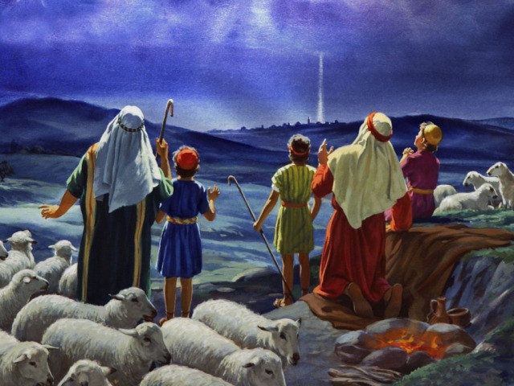
从惧怕到平安：牧羊人的降临节之旅 From Fear to Peace: The Shepherds’ Advent Journey 路/Luke 2：8-20

Slide 2
降临节——Advent——拉丁文：Adventus
降临节的英文是 Advent，来自拉丁文 adventus，意思是“到来”或“临到”。降临节有两层重要的含义：纪念与期盼。
“Advent” comes from the Latin word adventus, meaning “coming” or “arrival.” Advent carries two important meanings: remembrance and expectation.”

Slide 3
纪念主耶稣第一次的降临——神成为人，降生在伯利恒马槽中的婴孩/ To remember the first coming of the Lord Jesus---when God became man and was born as a baby in the manger of Bethlehem.
降临节
期盼主耶稣第二次的降临——祂将带来救赎与审判，使万物更新，荣耀显现/ To look forward to the second coming of the Lord Jesus---when He will bring redemption and judgment, renew all things, and reveal His glory.

Slide 4
降临节/Advent | 紫色、粉红色 | 紫色：悔改、预备、盼望； 粉红色：喜乐
圣诞节/Christmas | 白色 | 光明、喜乐、纯洁、神的荣耀
大斋期/Lent | 紫色 | 悔改、禁食、悔罪、灵性准备
受难日/Good Friday | 黑色 | 哀悼、悔改、纪念
复活节/Easter | 白色 | 复活、喜乐、胜利、荣耀
五旬节/Pentecost | 红色 | 圣灵、火焰、热情、力量
常年期/Ordinary Time | 绿色 | 成长、生命、希望、成熟的信仰生活

Slide 5

祈祷/Prayer

Slide 6
一、黑暗中的人——惧怕的现实 8-9 I. People in the Night---The Reality of Fear ( 8–9) 8在伯利恒之野地里有牧羊的人，夜间按着更次看守羊群。9有主的使者站在他们旁边，主的荣光四面照着他们。牧羊的人就甚惧怕。 8And there were shepherds living out in the fields near by, keeping watch over their flocks at night. 9An angel of the Lord appeared to them, and the glory of the Lord shone around them, and they were terrified.

Slide 7
二、天上的信息---神赐下平安 10-14节 II. The Message from Heaven---God Gives Peace 10–14 10那天使对他们说，不要惧怕，我报给你们大喜的信息，是关乎万民的。11因今天在大卫的城里，为你们生了救主，就是主基督。 10But the angel said to them, ‘Do not be afraid. I bring you good news that will cause great joy for all the people. 11Today in the town of David a Saviour has been born to you; he is the Messiah, the Lord.

Slide 8
13忽然有一大队天兵，同那天使赞美神说, 14在至高之处荣耀归与神，在地上平安归与他所喜悦的人。 13 Suddenly a great company of the heavenly host appeared with the angel, praising God and saying, 14‘Glory to God in the highest heaven,and on earth peace to those on whom his favour rests.’

Slide 9
路1：76孩子阿，你要称为至高者的先知。因为你要行在主的前面，预备他的道路。77叫他的百姓因罪得赦，就知道救恩。78因我们神怜悯的心肠，叫清晨的日光从高天临到我们，79要照亮坐在黑暗中死荫里的人。把我们的脚引到平安的路上。”

Slide 10
Luke 1: 76 And you, my child, will be called a prophet of the Most High; for you will go on before the Lord to prepare the way for him,77to give his people the knowledge of salvation through the forgiveness of theirsins,78because of the tender mercy of our God, by which the rising sun will come to us from heaven79to shine on those living in darkness and in the shadow of death, to guide our feet into the path of peace.’

Slide 11
77叫他的百姓因罪得赦 79要照亮坐在黑暗中死荫里的人。 77 知道救恩。 79把我们的脚引到平安的路上。

Slide 12
路1:77叫他的百姓因罪得赦, 知道救恩 79要照亮坐在黑暗中死荫里的人。 路2:11为你们生了救主，就是主基督。 太1:21 她将要生一个儿子，你要给他起名叫耶稣，因他要将自已的百姓从罪恶里救出来。

Slide 13
听那天使高声唱/Hark! the Herald Angels Sing “Hark! the herald angels sing, glory to the newborn King / 听那天使高声唱，荣耀归于新生王。” “Peace on earth and mercy mild, God and sinners reconciled / 地上有平安，温柔的怜悯，上帝与罪人和好/和解。”

Slide 14
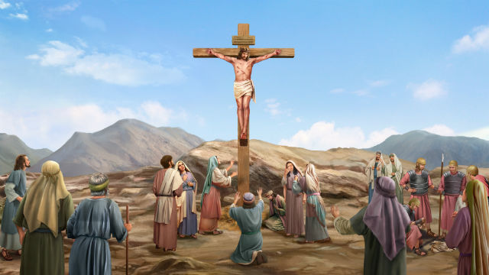
何14：4我必医治他们背道的病，甘心爱他们，因为我的怒气向他们转消。
耶和华神
怒气
怒气
怒气
饶恕
接纳

Slide 15
三、地上的回应---奔向耶稣的信心 15-20 III. The Response of Earth---A Faith that Runs to Jesus 15-20 15众天使离开他们升天去了，牧羊的人彼此说，我们往伯利恒去，看看所成的事，就是主所指示我们的。16他们急忙去了，就寻见马利亚和约瑟，又有那婴孩卧在马槽里。 12你们要看见一个婴孩，包着布，卧在马槽里。

Slide 16
20 牧羊的人回去了，因所听见所看见的一切事，正如天使向他们所说的，就归荣耀与神，赞美他。 20The shepherds returned, glorifying and praising God for all the things they had heard and seen, which were just as they had been told.

Slide 17
17 既然看见，就把天使论这孩子的话传开了。 17 When they had seen him, they spread the word concerning what had been told them about this child.

Slide 18
牧羊人 The Shepherds
从害怕到看见；
From fear to seeing
从看见到相信；
From seeing to believing
从相信到分享，
From believing to sharing

Slide 19
总结 Summary
11 今天在大卫的城里，为你们生了救主，就是主基督。 11 Today in the town of David a Saviour has been born to you; he is the Messiah, the Lord.

