Slide 1
“走出去”后的导引 徒8：26-40

Slide 2
祈祷/Prayer

Slide 3
但圣灵降临在你们身上，你们就必得着能力；并要在耶路撒冷、犹太全地和撒玛利亚，直到地极，作我的见证。 8But you will receive power when the Holy Spirit comes on you; and you will be my witnesses in Jerusalem, and in all Judea and Samaria, and to the ends of the earth.’ 徒/Acts 1:8

Slide 4
一、搅动巢穴，福音外传 I. Stirring The Nest，the Spread of the Gospel 1从这日起，耶路撒冷的教会，大遭逼迫。除了使徒以外，门徒都分散在犹太和撒玛利亚各处。2有虔诚的人，把司提反埋葬了，为他捶胸大哭。3扫罗却残害教会，进各人的家，拉着男女下在监里 On that day a great persecution broke out against the church in Jerusalem, and all except the apostles were scattered throughout Judea and Samaria. 2Godly men buried Stephen and mourned deeply for him. 3But Saul began to destroy the church. Going from house to house, he dragged off both men and women and put them in prison. 徒/Acts 8:1-3

Slide 5
8司提反满得恩惠能力，在民间行了大奇事和神迹。9当时有称利百地拿会堂的几个人……都起来，和司提反辩论。10司提反是以智慧和圣灵说话，众人敌挡不住。11就买出人来说，我们听见他说谤渎摩西和神的话。 8Now Stephen, a man full of God’s grace and power, performed great wonders and signs among the people. 9 Opposition arose, however, from members of the Synagogue of the Freedmen …began to argue with Stephen. 10But they could not stand up against the wisdom the Spirit gave him as he spoke.11Then they secretly persuaded some men to say, ‘We have heard Stephen speak blasphemous words against Moses and against God.’徒/Acts 6:8-11

Slide 6
8： 1从这日起，耶路撒冷的教会，大遭逼迫。除了使徒以外，门徒都分散在犹太和撒玛利亚各处……3 扫罗却残害教会，进各人的家，拉着男女下在监里。 On that day a great persecution broke out against the church in Jerusalem, and all except the apostles were scattered throughout Judea and Samaria… Saul began to destroy the church. Going from house to house, he dragged off both men and women and put them in prison. 徒/Acts 8:1-3

Slide 7
2：41节“门徒约添了3000人”； 2：47节“主将得救的人天天加给他们”； 4：4节“听道之人有许多信的，男丁数目约到5000” 徒/Acts 2:41, 47; 4:4

Slide 8
44信的人都在一处，凡物公用。45并且卖了田产家业，照各人所需用的分给各人。46他们天天同心合意，恒切地在殿里且在家中掰饼，存着欢喜诚实的心用饭， 44All the believers were together and had everything in common. 45They sold property and possessions to give to anyone who had need. 46Every day they continued to meet together in the temple courts. They broke bread in their homes and ate together with glad and sincere hearts, 徒/Acts 2:44-46

Slide 9
19你们要去，使万民作我的门徒。 19Therefore go and make disciples of all nations, 太/Matt.28:19 圣灵降临在你们身上，你们就必得着能力；并要在耶路撒冷、犹太全地和撒玛利亚，直到地极，作我的见证 8But you will receive power when the Holy Spirit comes on you; and you will be my witnesses in Jerusalem, and in all Judea and Samaria, and to the ends of the earth.’ 徒/Acts 1:8

Slide 10
二、腓利和埃塞俄比亚太监 II. Philip and the Ethiopian 26有主的一个使者对腓利说，起来，向南走，往那从耶路撒冷下迦萨的路上去，那路是旷野。 26Now an angel of the Lord said to Philip, ‘Go south to the road – the desert road – that goes down from Jerusalem to Gaza.’ 徒/Acts 8:26

Slide 11
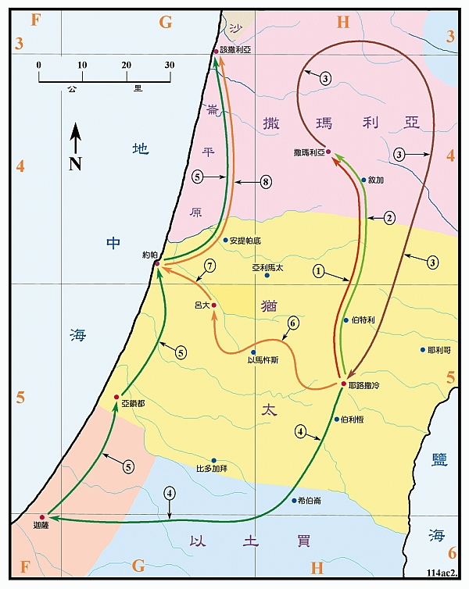

Slide 12
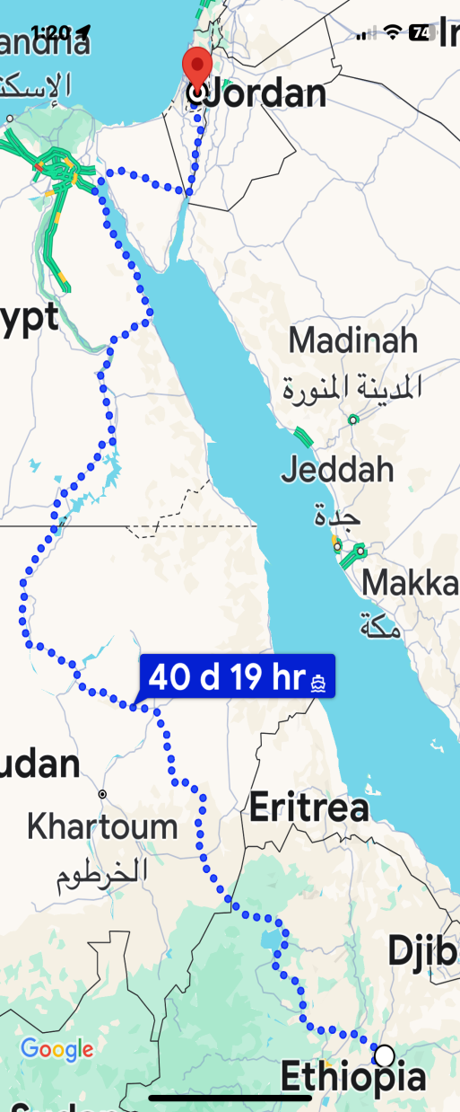
1、埃塞俄比亚的太监 1 . The Ethiopian 他是一个埃塞俄比亚人 他是一个被王所信任、位高权重的人 他是一个虔诚、在信仰上肯付代价的人 他是一个在信仰上有追求的人 他是一个谦卑的人 他是一个将福音带到埃塞俄比亚的人

Slide 13
埃塞俄比亚是一个具有悠久和丰富的基督宗教传统的国家，早期基督教从公元1世纪开始就已经在埃塞俄比亚北部和中部传播了。现在全国人口中67.3%信仰基督教（其中全国人口的43.8%信奉埃塞俄比亚正教，22.8%信奉基督新教，0.7%信奉天主教）。

Slide 14
2、 埃塞俄比亚太监的困惑 2. The perplexity of Ethiopian 3 若有人爱神，这人乃是神所知道的。 3 But whoever loves God is known by God. 林前/1Cor.8:3

Slide 15
3、腓利传福音的内容 3. The teaching of Philip the Evangelist 35 腓利就开口从这经上起，对他传讲耶稣。 35Then Philip began with that very passage of Scripture and told him the good news about Jesus. 徒/Acts 8:35

Slide 16
32 他像羊被牵到宰杀之地，又像羊羔在剪毛的人手下无声，他也是这样不开口。 33他卑微的时候，人不按公义审判他。谁能述说他的世代，因为他的生命从地上夺去。 32‘He was led like a sheep to the slaughter, and as a lamb before its shearer is silent, so he did not open his mouth.33In his humiliation he was deprived of justice. Who can speak of his descendants? For his life was taken from the earth.’ 徒/Acts 8:32-33

Slide 17
8: 4那些分散的人，往各处去传道。 4Those who had been scattered preached the word wherever they went. 徒/Acts 8:4 8:35腓利就开口从这经上起，对他传讲耶稣 35Then Philip began with that very passage of Scripture and told him the good news about Jesus. 徒/Acts 8:35

Slide 18
总结 Summary
5腓利下撒玛利亚城去，宣讲基督……8在那城里，就大有欢喜。39主的灵把腓利提了去，太监也不再见他了，就欢欢喜喜地走路。
5Philip went down to a city in Samaria and proclaimed the Messiah there.8So there was great joy in that city.
39the Spirit of the Lord suddenly took Philip away, and the eunuch did not see him again, but went on his way rejoicing.
徒/Acts 8:5-8; 39

