Slide 1
But I Would Not Let the Enemy Rob You
但我不容許仇敵搶奪你
John 約翰福音 10

Slide 2
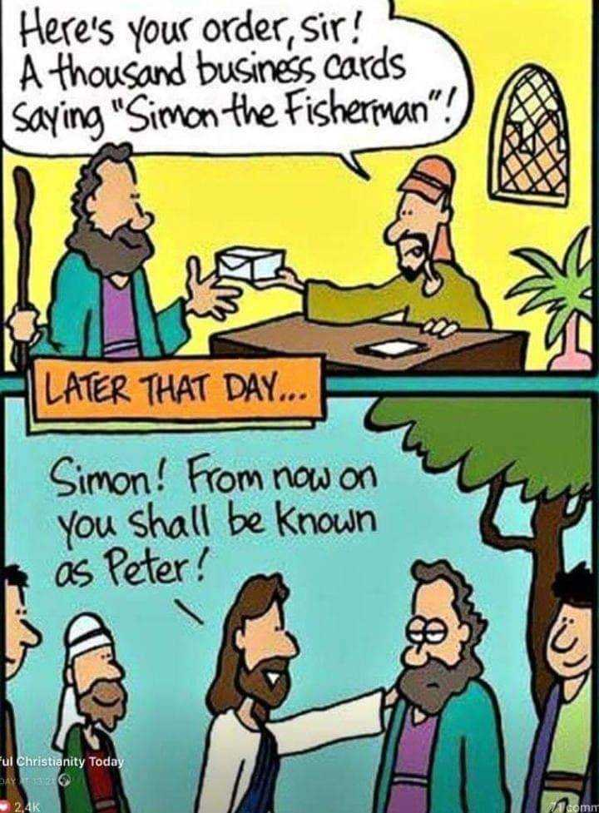
先生，這是您的訂單——1000張名片，上面印著：『漁夫西門』
當天晚些時候 …
「西門！從今以後，你要叫彼得了。」

Slide 3
John 10:1-12
“Very truly I tell you Pharisees, anyone who does not enter the sheep pen by the gate, but climbs in by some other way, is a thief and a robber. 2 The one who enters by the gate is the shepherd of the sheep. 3 The gatekeeper opens the gate for him, and the sheep listen to his voice. He calls his own sheep by name and leads them out. 4 When he has brought out all his own, he goes on ahead of them, and his sheep follow him because they know his voice. 5 But they will never follow a stranger; in fact, they will run away from him because they do not recognize a stranger’s voice.”
約翰福音 10:1–12
1我實實在在地告訴你們，人進羊圈，不從門進去，倒從別處爬進去，那人就是賊，就是強盜。
2從門進去的，才是羊的牧人。
3看門的就給他開門；羊也聽他的聲音。他按著名叫自己的羊，把羊領出來。
4既放出自己的羊來，就在前頭走，羊也跟著他，因為認得他的聲音。
5羊不跟著生人；因為不認得他的聲音，必要逃跑。

Slide 4
…9 I am the gate; whoever enters through me will be saved. They will come in and go out, and find pasture. 10 The thief comes only to steal and kill and destroy; I have come that they may have life, and have it to the full.
11 “I am the good shepherd. The good shepherd lays down his life for the sheep. 12 The hired hand is not the shepherd and does not own the sheep. So when he sees the wolf coming, he abandons the sheep and runs away. Then the wolf attacks the flock and scatters it.
… 9我就是門；凡從我進來的，必然得救，並且出入得草吃。
10盜賊來，無非要偷竊、殺害、毀壞；我來了，是要叫羊得生命，並且得的更豐盛。
11我是好牧人；好牧人為羊捨命。
12若是雇工，不是牧人，羊也不是他自己的，他看見狼來，就撇下羊逃走；狼抓住羊，趕散了羊群。

Slide 5
1.) A gate
John 10:9 - Jesus says “I am the gate; whoever enters through me will be saved. They will come in and go out, and find pasture.”
1) 一扇門
約翰福音 10:9 耶穌說 “我就是門；凡從我進來的，必然得救，並且出入得草吃。”

Slide 6
2.) There is - A Shepherd
John 10:11 – Jesus says “I am the good shepherd”
2) 有一位牧人
約翰福音 10:11 -耶穌說 “我是好牧人”

Slide 7

John 10:1 … anyone who does not enter the sheep pen by the gate, but climbs in by some other way, is a thief and a robber.
John 10: 10 The thief comes only to steal and kill and destroy; I (Jesus) have come that they may have life, and have it to the full.
Jesus is trying to tell you
Watch Out … The Enemy wants to Rob you
I am here to stop the Enemy from Robbing You & Give You Life.
約翰福音 10:1 … 人進羊圈，不從門進去，倒從別處爬進去，那人就是賊，就是強盜。
約翰福音 10:10 盜賊來，無非要偷竊、殺害、毀壞；我(耶穌)來了，是要叫羊得生命，並且得的更豐盛。
耶穌正在對你說：
要警醒……仇敵要搶奪你
我來，是要阻止仇敵搶奪你，並賜給你生命。

Slide 8

Who is the Enemy?
Sin - Loving Evil more than God
Selfishness - Loving Self more than God
Secular- Loving Created Things more than the Creator
Satan
誰是仇敵？
罪 —— 愛惡勝過愛神
自我中心 —— 愛自己勝過愛神
世俗 —— 愛受造之物勝過愛造物主
撒但

Slide 9
What is the Enemy trying to Rob you of ?
1.) Jesus’s Relationship with You
2.) Life & Life to the Full
3.) God’s Purposes for Your Life
仇敵想要從你身上搶奪什麼？
1.) 你與耶穌的關係
2.) 生命，以及更豐盛的生命
3.) 神在你生命中的旨意

Slide 10
How do I stop the Enemy from Robbing Me?
Ask of Forgiveness for Listening to & Following the Thief’s Voice
Renounce and Destroy the Thief’s Voice
Fight
Know & Listen to Jesus’s Voice
如何阻止仇敵搶奪我？
向神認罪悔改 —— 為自己曾聽從並跟隨盜賊的聲音求神赦免
棄絕並拆毀賊的聲音
爭戰
認識並聆聽耶穌的聲音

Slide 11
2.) There is - A Shepherd
John 10:11 – Jesus says “I am the good shepherd.
John 10:11 “The good shepherd lays down his life for the sheep.” –
Protects & Saves the Sheep.
John 10:3-4 “the sheep listen to his voice. He calls his own sheep by name and leads them out. …his sheep follow him because they know his voice.”
The Shepherd – guides, directs, leads the sheep to good pastures.
There is this “intimate relationship” between the Shepherd and the Sheep.
2.) 有一位牧人
約翰福音 10:11 - 耶穌說 “我是好牧人”
約翰福音 10:11 “好牧人為羊捨命”
祂保護並拯救羊群
約翰福音 10:3-4 “羊也聽他的聲音。他按著名叫自己的羊，把羊領出來。
既放出自己的羊來 … 羊也跟著他，因為認得他的聲音。
好牧人 —— 引導、指示、帶領羊進入美好的草場。
牧人與羊之間，存在著一種「親密的關係」。

