Slide 1
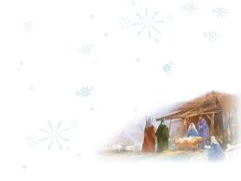
齊來 宗主信徒
O Come All Ye Faithful

Slide 2
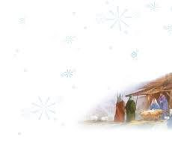
齊來,宗主信徒 快樂又歡欣
O come, all ye faithful, joyful and triumphant
齊來,一齊來 大家上伯利恆
O come ye, O come ye to Bethlehem
來朝見聖嬰 天使王已降生
Come and behold Him born the King of angels

Slide 3
齊來虔誠同崇拜 齊來虔誠同崇拜
齊來虔誠同崇拜 主基督
O come, let us adore Him
O come, let us adore Him
O come, let us adore Him
Christ, the Lord

Slide 4
天使結成樂隊 歡然同歌唱
Sing, choirs of angels, sing in exultation
光明眾天軍 來高聲同讚揚
O sing ,all ye citizens of heaven above
至高的處所 榮耀歸於君王
Glory to God, all glory in the highest

Slide 5
齊來虔誠同崇拜 齊來虔誠同崇拜
齊來虔誠同崇拜 主基督
O come, let us adore Him
O come, let us adore Him
O come, let us adore Him
Christ, the Lord

Slide 6
救主生於今晨 我眾來歡迎
Yea, Lord, we greet Thee born this happy morning
天人諸榮耀 完全歸主一身
O Jesus, to Thee be all glory given
大哉父本像 藉聖子來顯明
Word of the Father now in flesh appearing

Slide 7
齊來虔誠同崇拜 齊來虔誠同崇拜
齊來虔誠同崇拜 主基督
O come, let us adore Him
O come, let us adore Him
O come, let us adore Him
Christ, the Lord

