Slide 1
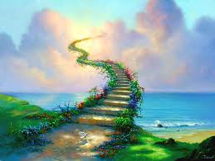
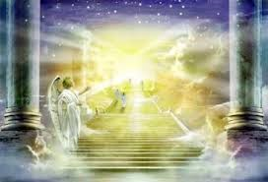
圣哉圣哉圣哉
Holy, Holy, Holy

Slide 2
圣哉圣哉圣哉 全能大主宰
清晨我众歌颂 欢声上达天庭
圣哉圣哉圣哉 慈悲全能主宰
赞美三一神 父子与圣灵
Holy, holy, holy! Lord God Almighty! Early in the morning our song shall rise to Thee; Holy, holy, holy, merciful and mighty! God in three Persons, blessed Trinity!

Slide 3
圣哉圣哉圣哉 众圣都敬拜
放下黄金冠冕 环绕在水晶海
千万天使天军 俯伏叩拜主前
昔在而今在 永在亿万年
Holy, holy, holy! All the saints adore Thee, Casting down their golden crowns around the glassy sea; Cherubim and seraphim falling down before Thee, Who was, and is, and evermore shall be.

Slide 4
圣哉圣哉圣哉 全能大主宰
地上天空海洋 万物同颂主名
圣哉圣哉圣哉 慈悲全能主宰
赞美三一神 父子与圣灵
Holy, holy, holy! Lord God Almighty! All Thy works shall praise Thy Name in earth, and sky, and sea; Holy, holy, holy; merciful and mighty! God in three Persons, blessed Trinity!

