Slide 1
我在這裡敬拜 Here I am to worship
神你是光 你照亮了黑暗
开我眼 让我看见 你的荣美 让我心渴慕你 希望与你不分离
Light of the world You stepped down into darkness. Opened my eyes, let me see. Beauty that made this heart adore You Hope of a life spent with You

Slide 2
所以, 我在这里敬拜 屈膝向你跪拜 大声宣告你是我的神 噢 你是如此美好 你是如此配得 我在这里敬拜你圣名
Here I am to worship Here I am to bow down Here I am to say that You're my God You're altogether lovely Altogether worthy, Altogether wonderful to me

Slide 3
万王之王坐在至高宝座上 散发荣耀的光芒 谦卑自己 来到你所造之地 为了爱牺牲自己
King of all days oh, so highly exalted Glorious in heaven above Humbly You came To the earth You created All for love's sake became poor

Slide 4
所以, 我在这里敬拜 屈膝向你跪拜 大声宣告你是我的神 噢 你是如此美好 你是如此配得 我在这里敬拜你圣名
Here I am to worship Here I am to bow down Here I am to say that You're my God You're altogether lovely Altogether worthy Altogether wonderful to me

Slide 5
我不知道多少代价 能使我罪钉上十架 (x2)
I'll never know how much it cost To see my sin upon that cross (x2)

Slide 6
我在这里敬拜 屈膝向你跪拜 大声宣告你是我的神 噢 你是如此美好 你是如此配得 我在这里敬拜你圣名 (x2)
Here I am to worship Here I am to bow down, Here I am to say that You're my God You're altogether lovely Altogether worthy Altogether wonderful to me (x2)

Slide 7
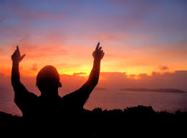
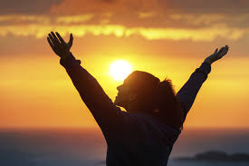
我在这里敬拜 Here I am to worship

