Slide 1

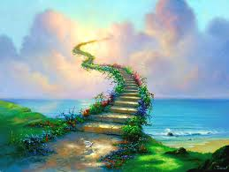
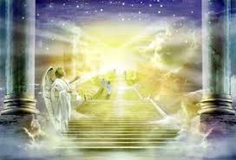
圣哉圣哉圣哉
Holy, Holy, Holy

Slide 2
圣哉！圣哉！圣哉！全能的大主宰！
清晨欢悦歌咏，高声颂主圣恩；
圣哉！圣哉！圣哉！恩慈永不更改！
荣耀与赞美，归三一真神 ！
Holy, holy, holy! Lord God Almighty!
Early in the morning our song shall rise to Thee;
Holy, holy, holy, merciful and mighty!
God in three Persons, blessed Trinity!

Slide 3

圣哉！圣哉！圣哉！圣徒虔诚敬拜，
各以华丽金冠，奉献宝座之前；
千万天使天军，谦敬崇拜上主，
昔在而今在，永在万万年。
Holy, holy, holy! All the saints adore Thee,
Casting down their golden crowns
around the glassy sea;
Cherubim and seraphim falling down before Thee,
Who was, and is, and evermore shall be.

