Slide 1
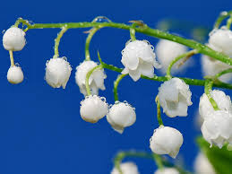
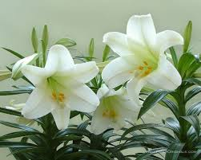
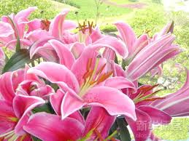
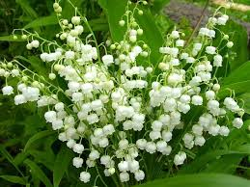
谷中百合花
The Lily of the Valley

Slide 2
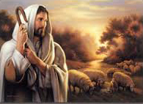
我有一位最好朋友
他就是主耶稣
他使饥渴心灵
常能得安慰
I have found a friend in Jesus He’s everything to me He’s the fairest of ten thousand to my soul
The lily of the valley 1-1

Slide 3
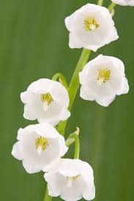
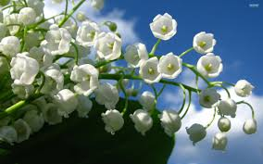
好比山谷中百合花
洁白 沌净 芳香
惟有救主耶稣
圣名最完美
The Lily of the Valley in Him alone I see All I need to cleanse and make me fully whole
The lily of the valley 1-2

Slide 4
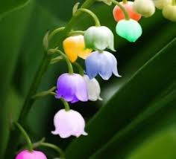
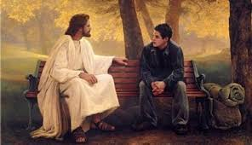
痛苦悲伤他怜悯
忧患时他安慰
他对我说
他永住在我心内
In sorrow He’s my comfort in trouble He’s my stay He tells me every care on Him to roll.
The lily of the valley 1-3

Slide 5
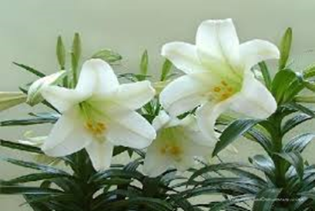
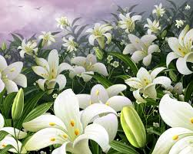
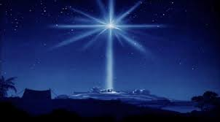
他是山谷中百合花
灿烂明亮晨星
他使饥渴心灵
常能得安慰
He’s the Lily of the Valley the Bright and Morning Star He’s the fairest of ten thousand to my soul.
The Lily of the Valley - refrain

Slide 6
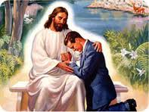
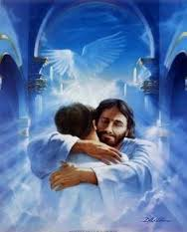
他除去我一切烦恼
担当患难忧伤
战胜试探
他作我坚固保障
He all my grief has taken and all my sorrows borne In temptation He’s my strong and mighty tow’r
The lily of the valley 2-1

Slide 7
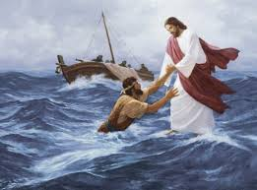
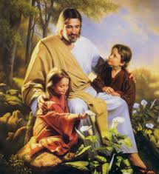
为他我愿舍去一切
抛弃心中偶像
他用全能臂膀
保守我安康
I have all for Him forsaken and all my idols torn From my heart and now He keeps me by His pow’r
The lily of the valley 2-2

Slide 8
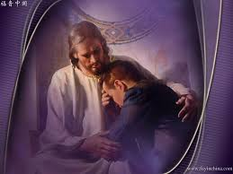
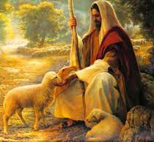
纵使亲朋离弃我
撒但试探引诱
依靠耶稣
心中平安有希望
Though all the world forsake me, and Satan tempt me sore, Through Jesus I shall safely reach the goal.
The lily of the valley 2-3

Slide 9
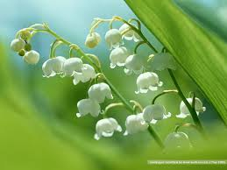
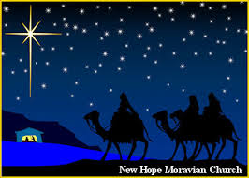
他是山谷中百合花
灿烂明亮晨星
他使饥渴心灵
常能得安慰
He’s the Lily of the Valley the Bright and Morning Star He’s the fairest of ten thousand to my soul
The Lily of the Valley - refrain

Slide 10
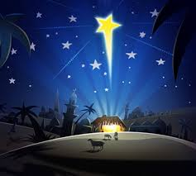
我是沙崙的玫瑰花 是谷中的百合花
I am a rose of Sharon a lily of the valleys
雅歌 Song 2:1
我是明亮的晨星
I am the bright Morning Star
啟 Re 22:16

Slide 11
他必永远不离开我
时常陪伴身旁
我必信靠耶稣
效法主榜样
He will never, never leave me, nor yet forsake me here, While I live by faith and do His blessed will;
The lily of the valley 3-1

Slide 12
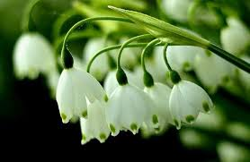
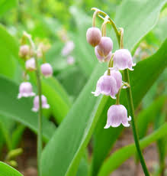
他是磐石给我力量
使软弱变刚强
心灵饥渴
他赐吗哪作灵粮
A wall of fire about me I’ve nothing now to fear From His manna He my hungry soul shall fill.
The lily of the valley 3-2

Slide 13
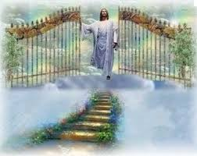
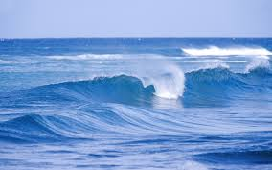
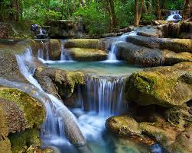
将来升天见主面
同享极大荣光
到达快乐彼岸
生命水流长
Then sweeping up to glory to see His blessed face Where rivers of delight shall ever roll.
The lily of the valley 3-3

Slide 14
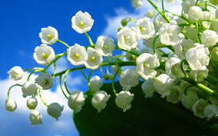
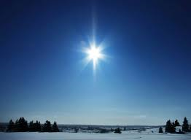
他是山谷中百合花
灿烂明亮晨星
他使饥渴心灵
常能得安慰
He’s the Lily of the Valley the Bright and Morning Star He’s the fairest of ten thousand to my soul
The Lily of the Valley - refrain

Slide 15
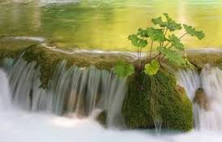
宝座中的羔羊必牧养他们、领他们到生命水的泉源
For the Lamb at the center of the throne will be their shepherd; he will lead them to springs of living water
启 Re 7:17

