Slide 2
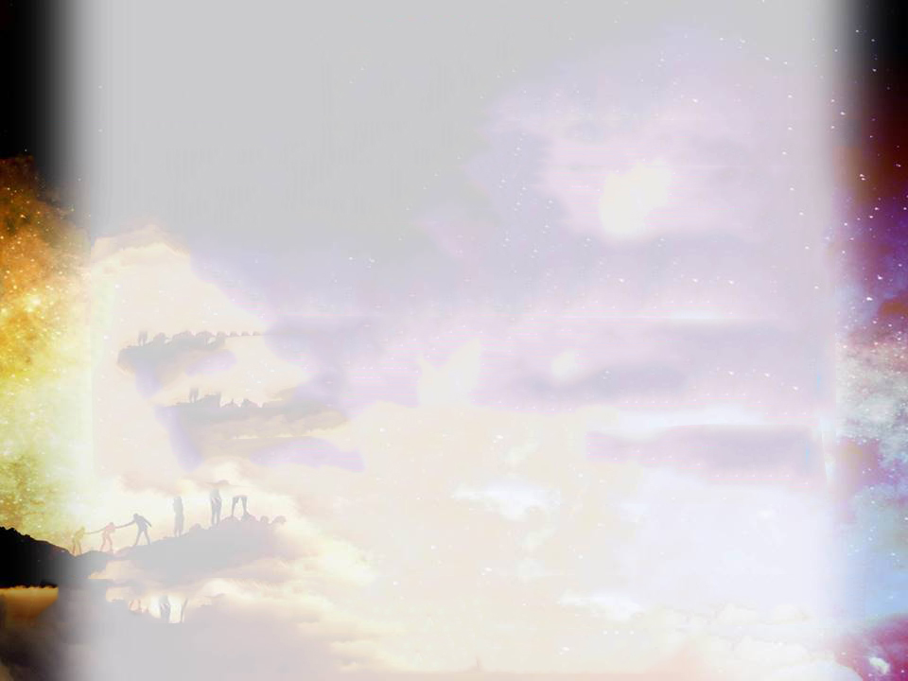
主耶稣因着爱进入我世界 献生命 为宣扬天国福音 我生命得释放 压制得自由 与他携手共建造 天国已近
The Lord Jesus entered my world with love He came to proclaim the good news of the kingdom of God and gave his life to redeem us
I am set free from oppression
Let’s walk with him to build his kingdom
The kingdom of heaven is near

Slide 4
主耶稣因着爱进入我世界 献生命 为宣扬天国福音 我生命得释放 压制得自由 与他携手共建造 天国已近
The Lord Jesus entered my world with love He came to proclaim the good news of the kingdom of God and gave his life to redeem us
I am set free from oppression
Let’s walk with him to build his kingdom
The kingdom of heaven is near

Slide 5
主 今天在这里 请差遣我们去 尽管泪水心中流 靠主恩典 立誓跟随到底 肩并肩 心连心 遥望着各各他 十字架呼唤我 步步前行
Lord, send us out today
Despite tears, by relying on the Lord’s grace we will follow the Lord to the end
Shoulder to shoulder, heart to heart, looking at Golgotha, the cross is calling me
I go forward step by step

Slide 7
我今天愿回应耶稣的邀请 勤工作 莫蹉跎 白昼已尽 每一天甘心背自己的十架 今生无悔跟从主 直到地极
Today, I want to respond to Jesus' invitation
Working hard, wasting no time
I willingly carry my own cross every day
I follow the Lord until the end of the earth without regret

Slide 8
主 今天在这里 请差遣我们去 尽管泪水心中流 靠主恩典 立誓跟随到底 肩并肩 心连心 遥望着各各他 十字架呼唤我 步步前行
Lord, send us out today
Despite tears, by relying on the Lord’s grace we will follow the Lord to the end
Shoulder to shoulder, heart to heart, looking at Golgotha, the cross is calling me
I go forward step by step

Slide 9
主 今天在这里 请差遣我们去 尽管泪水心中流 靠主恩典 立誓跟随到底 肩并肩 心连心 遥望着各各他 十字架呼唤我 步步前行
Lord, send us out today
Despite tears, by relying on the Lord’s grace we will follow the Lord to the end
Shoulder to shoulder, heart to heart, looking at Golgotha, the cross is calling me
I go forward step by step

Slide 11
服事主 漫长路 有时会孤独 想放弃主托付 回首频频 重温十架的爱 圣灵在提醒 耶稣降卑为人子 为我舍命
I sometimes feel lonely when serving Lord in this long journey
There are times I want to give up the work Lord gave to me
The Holy Spirit reminds me to remember the love of cross Jesus laid down his life for me

Slide 12
主 今天在这里 请差遣我们去 尽管泪水心中流 靠主恩典 立誓跟随到底 肩并肩 心连心 遥望着各各他 十字架呼唤我 步步前行
Lord, send us out today
Despite tears, by relying on the Lord’s grace we will follow the Lord to the end
Shoulder to shoulder, heart to heart, looking at Golgotha, the cross is calling me
I go forward step by step

Slide 13
主 今天在这里 请差遣我们去 尽管泪水心中流 靠主恩典 立誓跟随到底 肩并肩 心连心 遥望着各各他 十字架呼唤我 步步前行
Lord, send us out today
Despite tears, by relying on the Lord’s grace we will follow the Lord to the end
Shoulder to shoulder, heart to heart, looking at Golgotha, the cross is calling me
I go forward step by step

Slide 14
哦 十字架 十字架 我永远的荣耀 直到我安息天家 仍夸耶稣十架
Oh, the cross, the cross, my glory forever
I will boast nothing but the cross of Jesus until I rest in peace

Slide 16
主耶稣在等待 你我的回应 你为何在犹豫 不敢前进？ 遥望十架光芒 听见主呼唤 点燃生命为主活 天国降临
The Lord Jesus is waiting for our response Why are you hesitating? Why are you not moving forward?
Looking at the light of the cross, hearing the Lord call
It releases the file of my life for the Lord
The kingdom of heaven is coming

