Slide 1
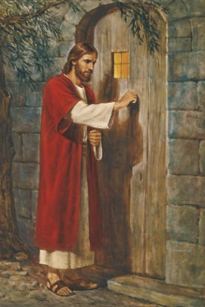
救主在等待(S436) The Savior Is Waiting
主耶穌在等待進入你心們， 為何你不接受他?
這世界無法將你與主分開 ，你要如何回答他?
The savior is waiting to enter your heart, why don’t you let him come in.
There’s nothing in this world to keep you a part, what is your answer to him?

Slide 2
救主在等待(S436) The Savior Is Waiting
他 耐心地在你心外等待 ，現在他仍然在等待
等待 盼望你願意打開心門 ，他渴望進入你心
Time after time He has waited before,
And now He is waiting again
To see if you’re willing to open the door:
O how He wants to come in

Slide 3
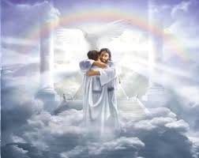
救主在等待 (S436) The Savior Is Waiting
哦朋友你若願意接近主耶穌， 他會伸慈手歡迎;
脫離黑暗接受他做你救主, 他必永住在你心
If you’ll take one step toward the Savior, my friend,
You’ll find His arms open wide;
Receive Him and all of your darkness will end,
Within your heart He’ll abide.

Slide 4
救主在等待(S436) The Savior Is Waiting
他 耐心地在你心外等待 ，現在他仍然在等待
等待 盼望你願意打開心門 ，他渴望進入你心
Time after time He has waited before,
And now He is waiting again
To see if you’re willing to open the door:
O how He wants to come in

Slide 5
救主在等待(S436) The Savior Is Waiting
哦朋友你若願意接近主耶穌， 他會伸慈手歡迎;
脫離黑暗接受他做你救主, 他必永住在你心
If you’ll take one step toward the Savior, my friend,
You’ll find His arms open wide;
Receive Him and all of your darkness will end,
Within your heart He’ll abide.

Slide 6
救主在等待(S436) The Savior Is Waiting
他 耐心地在你心外等待 ，現在他仍然在等待
等待 盼望你願意打開心門 ，他渴望進入你心
Time after time He has waited before,
And now He is waiting again
To see if you’re willing to open the door:
O how He wants to come in

