Slide 1
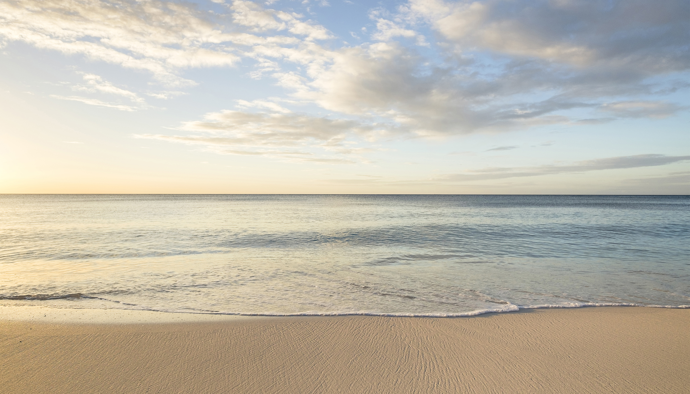
更加甘甜
W. C. Martin

Slide 2
我心感覺與主耶穌每日更加親近，
To Jesus ev'ry day I find my heart is closer drawn,
祂比黎明燦爛金色榮光更加明艷；
He's fairer than the glory of the gold and purple dawn;
祂就是我所追求的一切幻想美夢，
He's all my fancy pictures in its fairest dreams, and more,
祂一天比一天更加美麗、芬芳、甘甜。
Each day He grows still sweeter than He was the day before.
更加甘甜 1/3

Slide 3
一半、也猜想不到，金色海岸那邊；
The half cannot be fancied, this side the golden shore;
那日我主比以前更加美麗，更甘甜。
O there He'll be still sweeter than He ever was before.
更加甘甜 副歌 1/3

Slide 4
當我遠遠見主祂的榮光向我照耀，
His glory broke upon me when I saw Him from afar,
祂比晨星更明亮，比百合花更鮮艷；
He's fairer than the lily, brighter than the morning star;
祂使我渴慕的心靈得著滋潤滿足，
He fills and satisfies my longing spirit o'er and o’er,
祂一天比一天更加美麗、芬芳、甘甜。
Each day He grows still sweeter than He was the day before.
更加甘甜 2/3

Slide 5
一半、也猜想不到，金色海岸那邊；
The half cannot be fancied, this side the golden shore;
那日我主比以前更加美麗，更甘甜。
O there He'll be still sweeter than He ever was before.
更加甘甜 副歌 2/3

Slide 6
我心雖有時沉重，祂卻帶來甘甜愛，
My heart is sometimes heavy but he comes with sweet relief,
當我挫敗而喪氣，祂卻擁我入祂懷；
He folds me to His bosom when I droop with blighting grief;
祂如此擔我重負，我心怎不將祂戀，
I love the Christ who all my burdens in His body bore,
祂一天比一天更加美麗、芬芳、甘甜。
Each day He grows still sweeter than He was the day before.
更加甘甜 3/3

Slide 7
一半、也猜想不到，金色海岸那邊；
The half cannot be fancied, this side the golden shore;
那日我主比以前更加美麗，更甘甜。
O there He'll be still sweeter than He ever was before.
更加甘甜 副歌 3/3

