Slide 1
祂藏我灵
S82
He Hideth My Soul
Fanny J. Crosby
William J. Kirkpatrick

Slide 2
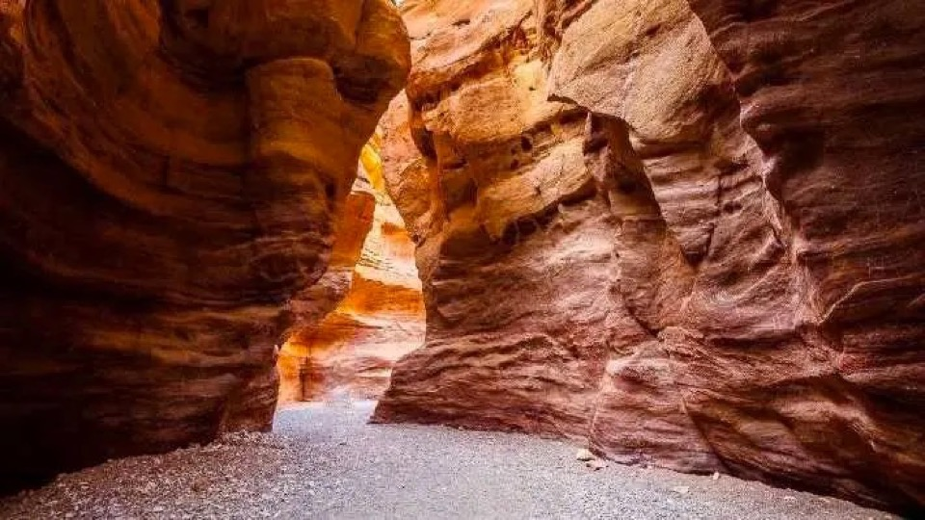
祂藏我灵魂在磐石洞穴里 如干渴之地得荫蔽 祂藏我生命在祂大慈爱里 用祂全能手来扶持 用祂全能手来扶持
He hideth my soul in the cleft of the rock That shadows a dry, thirsty land He hideth my life in the depths of His love And covers me there with His hand And covers me there with His hand
祂藏我灵 副歌

Slide 3
奇妙的救主就是耶稣我主 这奇妙的救主属我 祂藏我灵魂在于磐石洞中 使我得见喜乐江河
A wonderful Savior is Jesus my Lord
A wonderful Savior to me
He hideth my soul in the cleft of the rock
where rivers of pleasure I see
祂藏我灵 1/3

Slide 4
奇妙的救主就是耶稣我主 祂将我的重担挪去 扶持保守我使我不至动摇 祂赐我力量及所需
A wonderful Savior is Jesus my Lord He taketh my burden away He holdeth me up and I shall not be moved He giveth me strength for each day
祂藏我灵 2/3

Slide 5
祂藏我灵魂在磐石洞穴里 如干渴之地得荫蔽 祂藏我生命在祂大慈爱里 用祂全能手来扶持 用祂全能手来扶持
He hideth my soul in the cleft of the rock That shadows a dry, thirsty land He hideth my life in the depths of His love And covers me there with His hand And covers me there with His hand
祂藏我灵 副歌

Slide 6
每时每刻祂赐我恩惠无穷 祂灵又充满我心中 愿与众圣徒一齐歌唱欢呼 完美救恩奇妙救主
With numberless blessings each moment He crowns And filled with His fullness divine His perfect salvation, His wonderful love I'll shout with the millions on high
祂藏我灵 3/3

Slide 7
祂藏我灵魂在磐石洞穴里 如干渴之地得荫蔽 祂藏我生命在祂大慈爱里 用祂全能手来扶持 用祂全能手来扶持
He hideth my soul in the cleft of the rock That shadows a dry, thirsty land He hideth my life in the depths of His love And covers me there with His hand And covers me there with His hand
祂藏我灵 副歌

