Slide 1



數算主恩
Count Your Blessings

Slide 2
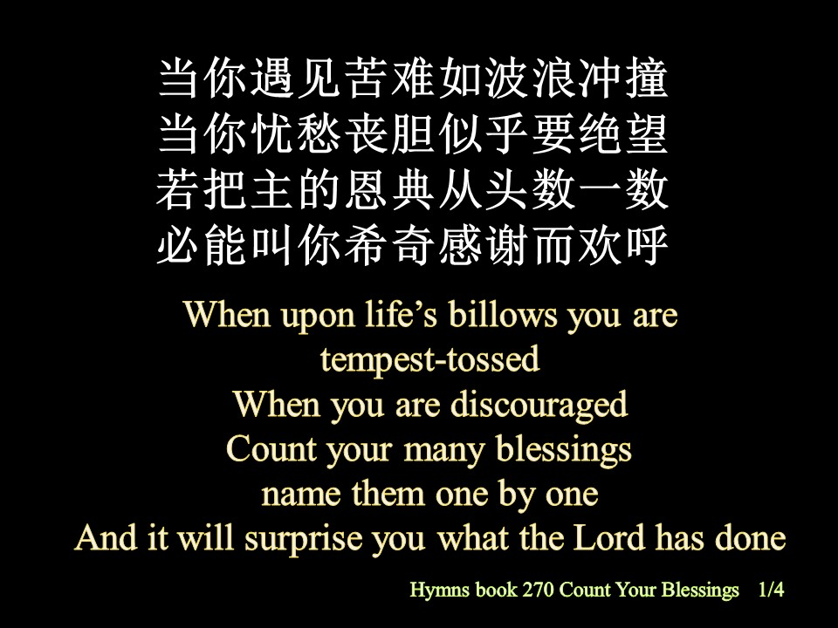
当你遇见苦难如波浪冲撞
当你忧愁丧胆似乎要绝望
若把主的恩典从头数一数
必能叫你希奇感谢而欢呼
When upon life’s billows you are
tempest-tossed
When you are discouraged
Count your many blessings
name them one by one
And it will surprise you what the Lord has done

Slide 3
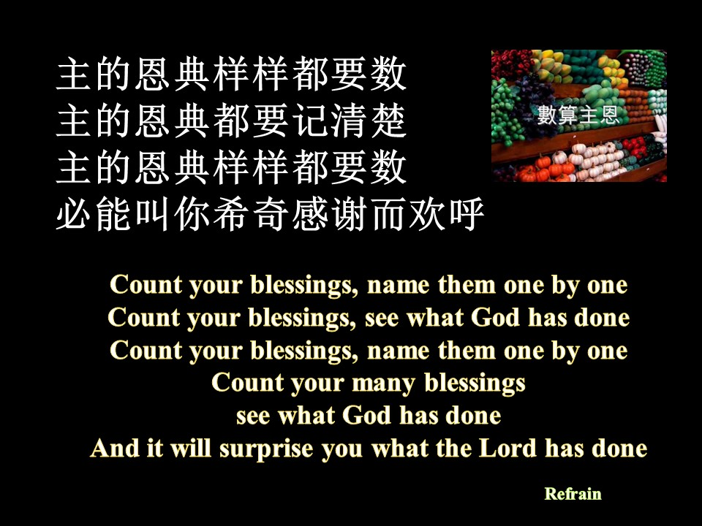

主的恩典样样都要数
主的恩典都要记清楚
主的恩典样样都要数
必能叫你希奇感谢而欢呼
Count your blessings, name them one by one
Count your blessings, see what God has done
Count your blessings, name them one by one
Count your many blessings
see what God has done
And it will surprise you what the Lord has done

Slide 4
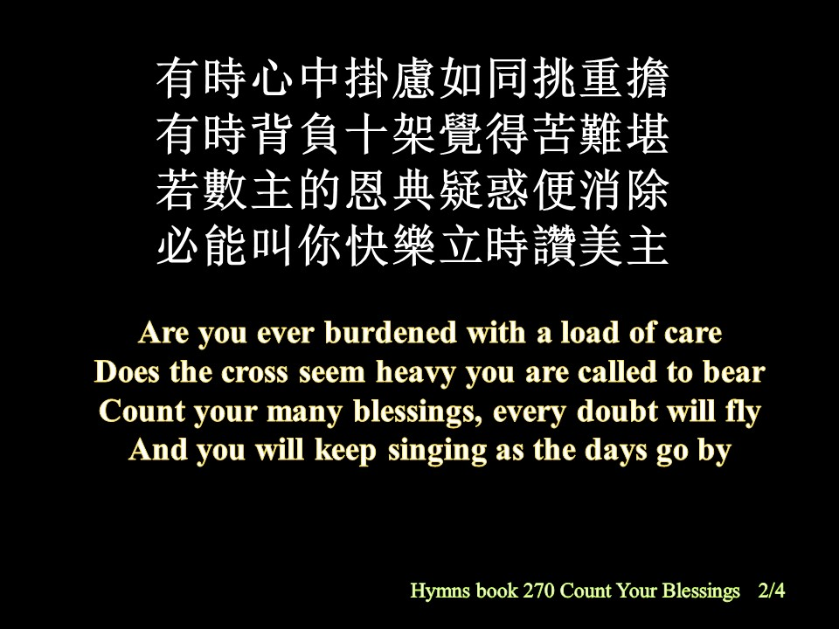
有時心中掛慮如同挑重擔
有時背負十架覺得苦難堪
若數主的恩典疑惑便消除
必能叫你快樂立時讚美主
Are you ever burdened with a load of care
Does the cross seem heavy you are called to bear
Count your many blessings, every doubt will fly
And you will keep singing as the days go by
Hymns book 270 Count Your Blessings 2/4

Slide 5
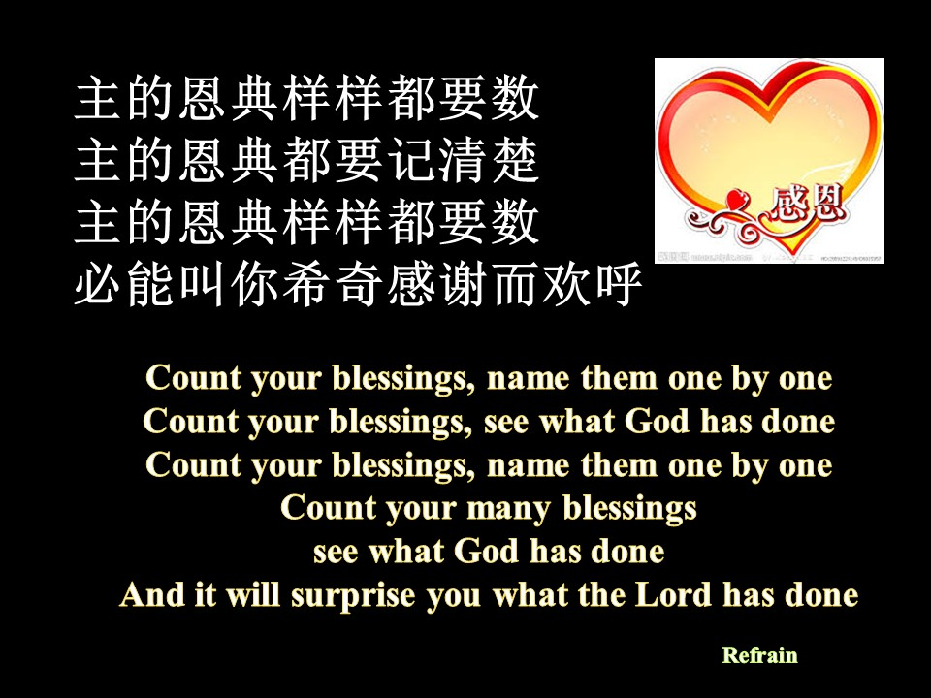

主的恩典样样都要数
主的恩典都要记清楚
主的恩典样样都要数
必能叫你希奇感谢而欢呼
Count your blessings, name them one by one
Count your blessings, see what God has done
Count your blessings, name them one by one
Count your many blessings
see what God has done
And it will surprise you what the Lord has done

Slide 6
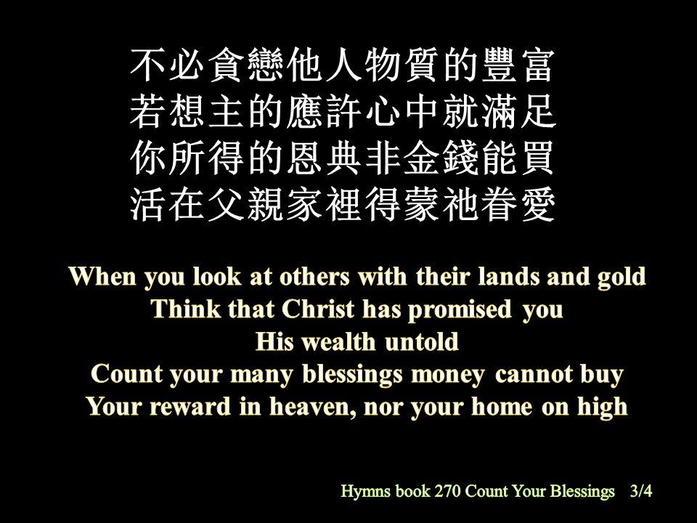
不必貪戀他人物質的豐富
若想主的應許心中就滿足
你所得的恩典非金錢能買
活在父親家裡得蒙祂眷愛
When you look at others with their lands and gold
Think that Christ has promised you
His wealth untold
Count your many blessings money cannot buy
Your reward in heaven, nor your home on high

Slide 7
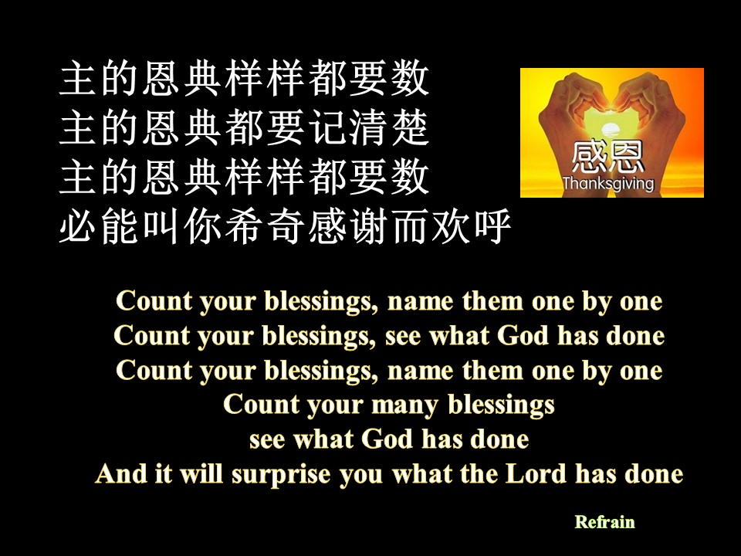

主的恩典样样都要数
主的恩典都要记清楚
主的恩典样样都要数
必能叫你希奇感谢而欢呼
Count your blessings, name them one by one
Count your blessings, see what God has done
Count your blessings, name them one by one
Count your many blessings
see what God has done
And it will surprise you what the Lord has done

Slide 8

我的心哪，你要称颂耶和华，凡在我里面的，也要称颂他的圣名！我的心哪，你要称颂耶和华，不可忘记他的一切恩惠！
Praise the Lord, my soul; all my inmost being, praise his holy name. Praise the Lord, my soul, and forget not all his benefits --

Slide 9
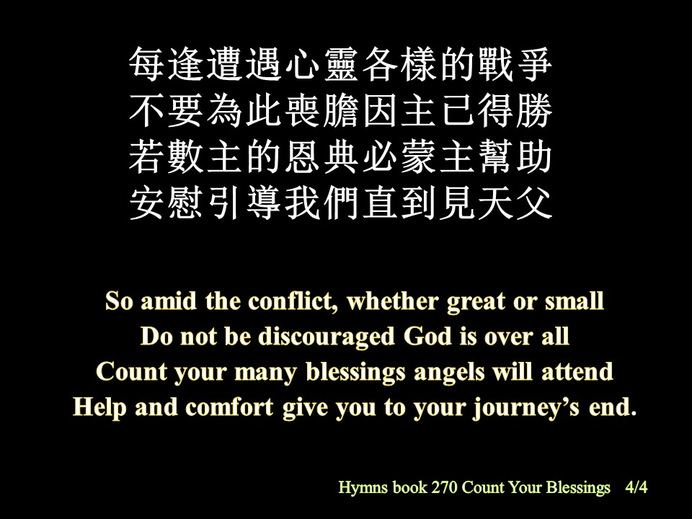
每逢遭遇心靈各樣的戰爭
不要為此喪膽因主已得勝
若數主的恩典必蒙主幫助
安慰引導我們直到見天父
So amid the conflict, whether great or small
Do not be discouraged God is over all
Count your many blessings angels will attend
Help and comfort give you to your journey’s end.

Slide 10
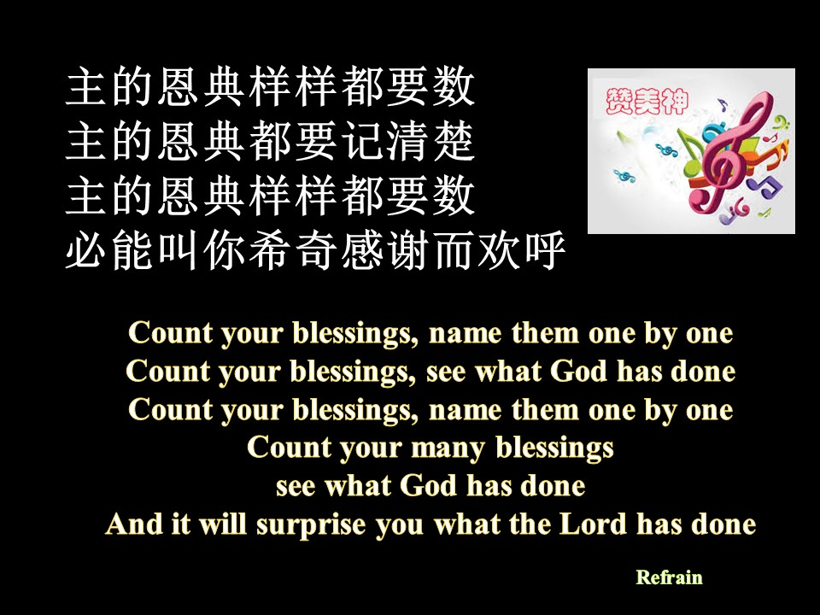

主的恩典样样都要数
主的恩典都要记清楚
主的恩典样样都要数
必能叫你希奇感谢而欢呼
Count your blessings, name them one by one
Count your blessings, see what God has done
Count your blessings, name them one by one
Count your many blessings
see what God has done
And it will surprise you what the Lord has done

Slide 11
主的恩典样样都要数
主的恩典都要记清楚
主的恩典样样都要数
必能叫你希奇感谢而欢呼
Count your blessings, name them one by one
Count your blessings, see what God has done
Count your blessings, name them one by one
Count your many blessings
see what God has done
And it will surprise you what the Lord has done

