Slide 1
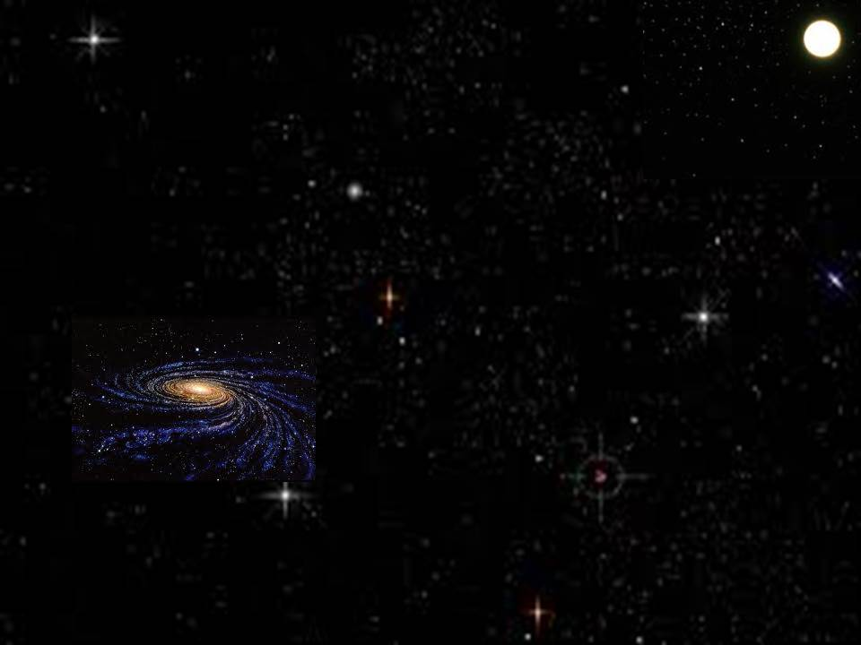
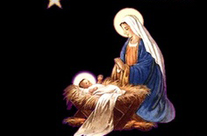
她将要生一个儿子，你要给他起名叫耶稣，因他要将自己的百姓从罪恶里救出来。
马槽圣婴
Away in a manger
She will give birth to a son, and you are to give him the name Jesus, because he will save his people from their sins.
Matthew 1:21
S120

Slide 2
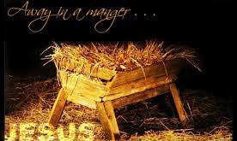
远远在马槽里 无枕也无床 小小的主耶稣 睡觉很安康 众星星都望着 主睡的地方 小小的主耶稣 睡在干草上
Away in a manger no crib for a bed The little Lord Jesus lay down his sweet head The stars in the sky looked down where He lay The little Lord Jesus asleep on the hay

Slide 3
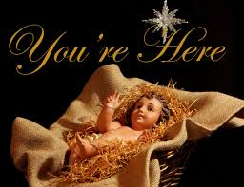
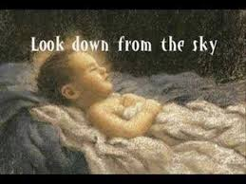
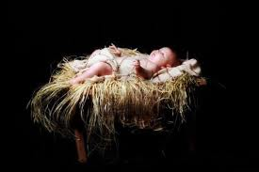
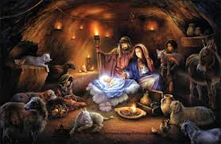
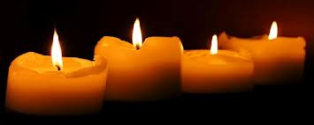
The cattle are lowing The baby awakes But little Lord Jesus No crying he makes I love you Lord Jesus Look down from the sky And stay by my cradle 'Til morning is night
众牲畜呜呜叫 圣婴忽惊醒 小小的主耶稣 却无啼哭声 我真爱主耶稣 敬求近我身 靠近我小床边 守我到天明

Slide 4
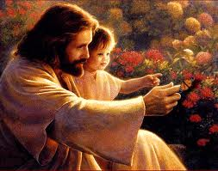
Be near me Lord Jesus I ask Thee to stay Close by me forever and love me I pray Bless all the dear children In Thy tender care And take us to heaven to live with Thee there
恭敬求主耶稣 靠近我身旁 爱护我 接受我 做主的小羊 也保护众儿女 一齐都安康 教我们都能够 跟主到天堂

