Slide 1
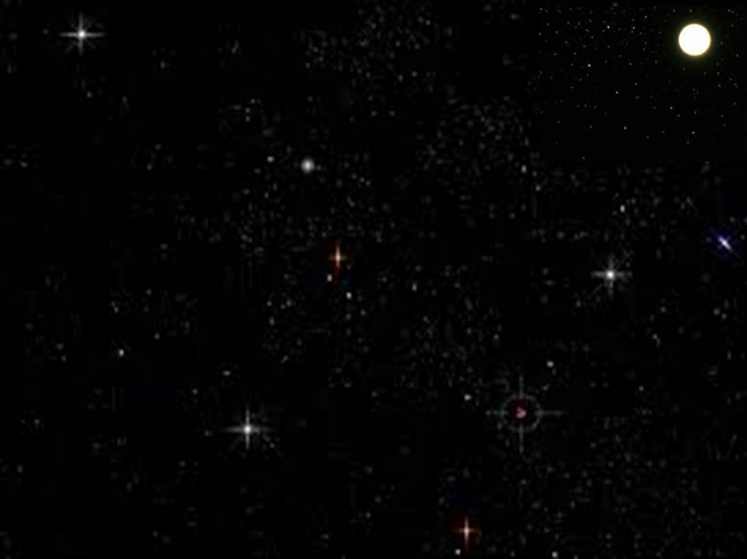
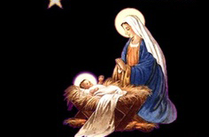
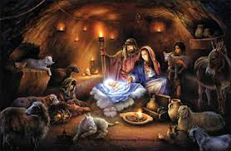
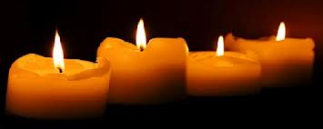
平安夜
Silent Night

Slide 2
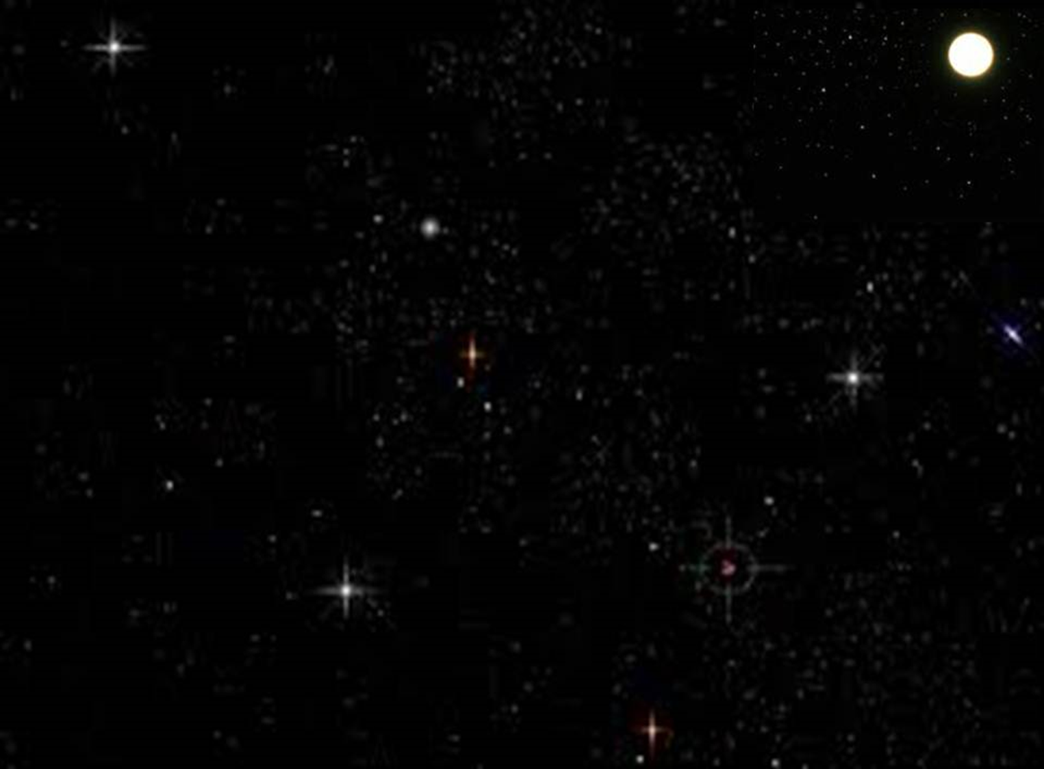
平安夜，圣善夜！ 万暗中，光华射 照着圣母也照着圣婴 多少慈详也多少天真 静享天赐安眠，静享天赐安眠
Silent night, Holy night All is calm, all is bright Round yon virgin, mother and child Holy infant, so tender and mild Sleep in heavenly peace (x2)

Slide 3
Silent night, Holy night All is calm, all is bright Round yon virgin, mother and child Holy infant, so tender and mild Sleep in heavenly peace (x2)
平安夜，圣善夜！ 万暗中，光华射 照着圣母也照着圣婴 多少慈详也多少天真 静享天赐安眠，静享天赐安眠

Slide 4
平安夜，圣善夜！牧羊人，在旷野 忽然看见了天上光华 听见天军唱哈利路亚 救主今夜降生，救主今夜降生！
Silent night, Holy night Shepherds quake, at the sight Glories stream from heaven above Heavenly, hosts sing Hallelujah. Christ the Savior is born (x2)

Slide 5
平安夜，圣善夜！神子爱，光皎洁 救赎宏恩的黎明来到 圣容发出来荣光普照 耶稣我主降生，耶稣我主降生！
Silent night, Holy night Son of God, love's pure light Radiant beams from thy holy face With the dawn of redeeming grace, Jesus, Lord at thy birth (x2)

