Slide 1


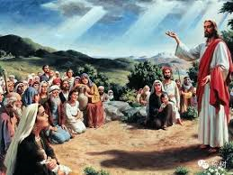


福
Blessings

Slide 2

（男）虚心的人有福了 天国是他们的
哀恸的人有福了 他们必得安慰
Blessed are the poor in spirit
for theirs is the kingdom of heaven
Blessed are those who mourn
for they will be comforted

Slide 3
（女）温柔的人有福了 他们必承受地土
饥渴慕义的人有福了 他们必得饱足
Blessed are the meek
for they will inherit the earth
Blessed are those who hunger and thirst for righteousness, for they will be filled

Slide 4
（男女）内心清洁的 看见上帝
使人和睦的 他的儿女
Those who are the pure in heart
will see God
Peacemakers will be called
children of God

Slide 5
（男女）为义受苦的 应当欢喜
他们的赏赐 大的无比
Those who are persecuted for righteousness should be joyful
for they will be greatly rewarded

Slide 6
（男）虚心的人有福了 天国是他们的
哀恸的人有福了 他们必得安慰
（女）呜…
Blessed are the poor in spirit
for theirs is the kingdom of heaven
Blessed are those who mourn
for they will be comforted

Slide 7
（女）温柔的人有福了 他们必承受地土
饥渴慕义的人有福了 他们必得饱足
（男）呜…
Blessed are the meek
for they will inherit the earth
Blessed are those who hunger and thirst for righteousness, for they will be filled

Slide 8
（男女）内心清洁的 看见上帝
使人和睦的 他的儿女
Those who are the pure in heart
will see God
Peacemakers will be called
children of God

Slide 9
（男女）为义受苦的 应当欢喜
他们的赏赐 大的无比
Those who are persecuted for righteousness should be joyful
for they will be greatly rewarded

Slide 10
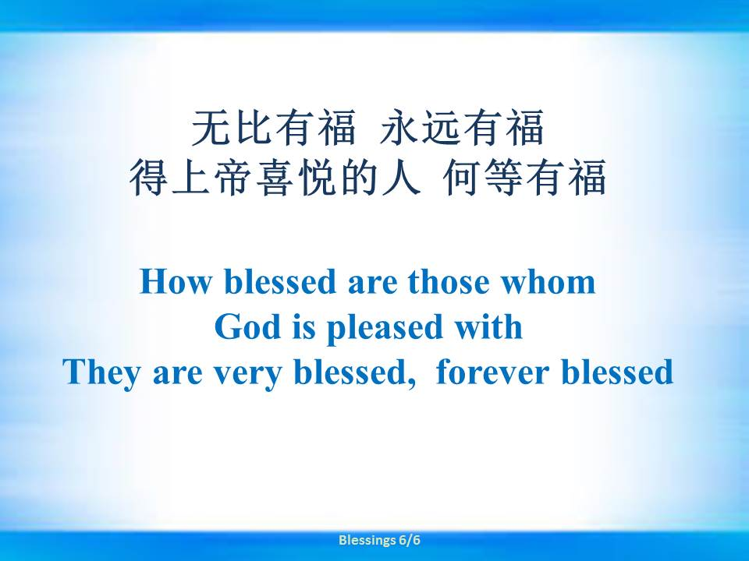

Slide 11

福
福
福
福
福
福
福
福
Blessings

